Slide 1
Learn
Connected Speech
with Matt Purland

Slide 2
Believe in the power of connected speech!

Slide 3
A new 8-part English pronunciation course by Matt Purland

Slide 4
Lesson 8:
Multiple Actions

Slide 5
Unit 8.2
Why multiple actions?

Slide 6
Why do we need multiple actions?
The problem which forces us to use multiple actions is simple: too many consonant sounds gathering at the end of the first syllable in a pair, making it harder to get to the necessary vowel sound or friendly consonant sound that makes a good connection.

Slide 7
What causes multiple consonant sounds to gather at the end of the first syllable? In general: consonant blends and the letter ‘s’, which is usually pronounced z.
Consonant blends like nd in ‘friend’, followed by ‘s’, create a 3-letter consonant blend: ‘nds’, which is unhelpful for us, because it is harder to get to the friendly consonant sound n that we need to make a good connection.

Slide 8
The cause for the prevalence of z at the end of the first syllable (Lesson 4) can be summarised as follows:
Apart from common words ending in z, this is caused by the word being plural, in a contraction, possessive ‘s’, or s form in present simple:
the friends were ‘s’ is plural
her friend’s quite nice ‘s’ is in a contraction
her friend’s book was ‘s’ shows possession
he befriends them ‘s’ is s form in present simple

Slide 9
Blend + ‘s’ gives us multiple consonant sounds at the end of a syllable, which have to be dealt with by multiple actions. For example:
the friends were } the frien swere
her friend’s quite nice } her frien squite
her friend’s book was } her frien sbook
he befriends them } he befrien sthem
mf z
change z to s
del d in blend
rest on n

Slide 10
With blends we will look at three different situations:
blends with a friendly consonant sound – with and without ‘s’
blends without a friendly consonant sound – with and without ‘s’
blends caused by regular verbs ending in ‘-ed’

Slide 11
But let’s back up a bit and start with sound connections which don’t need any actions.

Slide 12
0 Actions:
VC and friendly connections are already good – no action required!

Slide 13
1 Action:
These are the actions we mentioned above:
These are single actions and form most of the actions that we do in connected speech.

Slide 14
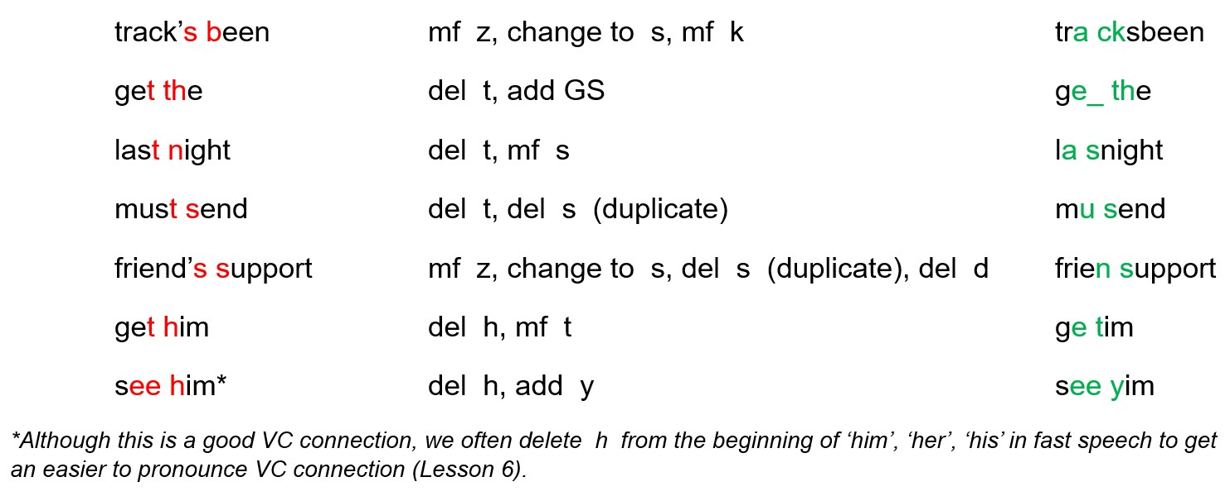
2+ Actions:
These are actions that we have studied in Lessons 3-7. They are not based on blend + ‘s’. For example:

Slide 15
Note that we are dealing with mainly unvoiced consonant sounds – f, k, p, s, t, tt – which move forward without changing. Voiced consonant sounds change to unvoiced in CC connections. For example, v changes to f in the phrase ‘have some’: ha fsome, and z changes to s in ‘likes them’: lai ksthm.

Slide 16
Note also that the actions we use are the same as always. We follow the patterns as discussed in previous lessons:
move forward (most of the actions)
delete t, d, h, and duplicate sounds when necessary
add w, y, and r in VV connections when necessary
add glottal stops. We add a glottal stop when t is deleted next to a vowel sound or friendly consonant sound; in other words, when we can no longer move forward or delete another consonant sound
change voiced consonant sounds to unvoiced (when necessary)

