Slide 1
Learn
Connected Speech
with Matt Purland

Slide 2
Believe in the power of connected speech!

Slide 3
A new 8-part English pronunciation course by Matt Purland

Slide 4
Lesson 7:
Adding Sounds

Slide 5
Unit 7.2
VV Connections

Slide 6
VV connections are less common than the other connections because fewer words begin or end with a vowel sound in English.
In more syllable pairs, the first sound is a consonant sound, which meets either a vowel sound (CV connection) or another consonant sound (CC connection).

Slide 7
However, there are many common function words that end with a vowel sound, and these are often the words that create VV connections when they meet another word beginning with a vowel sound.
In the 100 Most Common Words in Written English list there are 42 high-frequency words ending with a vowel sound.

Slide 8
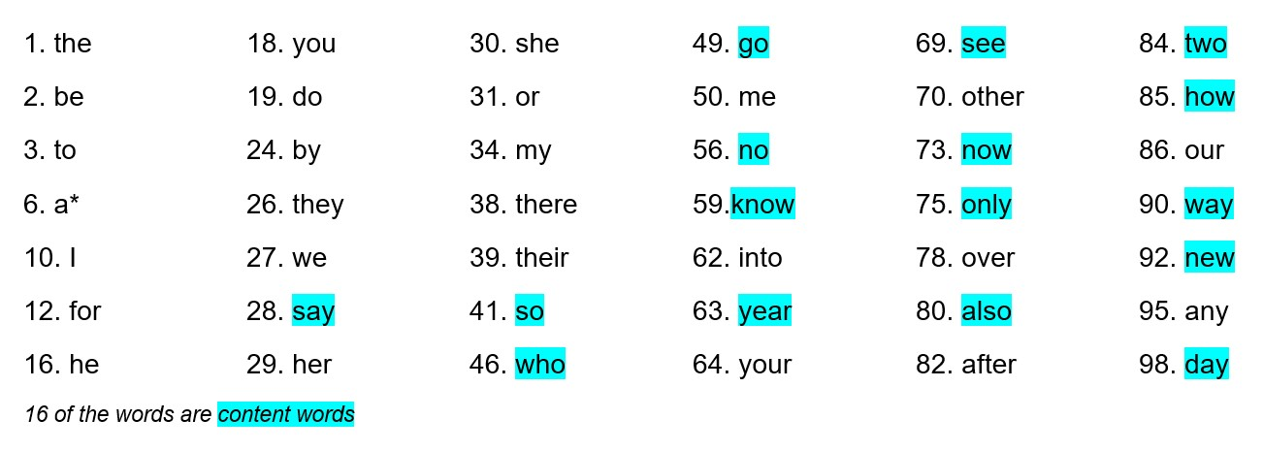
26 of them are function words – including almost half of the most common 40 words:

Slide 9
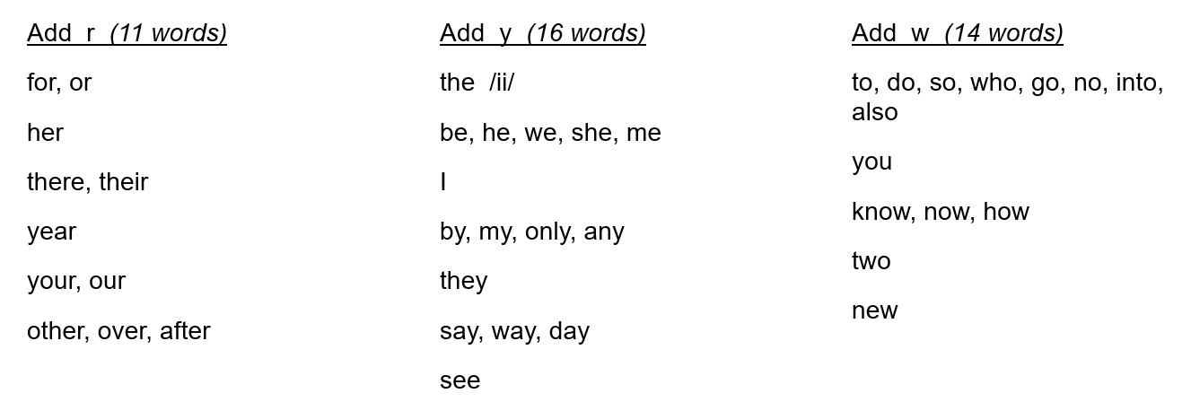
We can put these words into groups according to which sound we need to add:
*a = impossible because it does not connect with a vowel sound; use ‘an’ instead

Slide 10
Most of these words have the word shape C-V: they start with a consonant sound and end with a vowel sound.
If the next word or syllable begins with a vowel sound, you will have a VV connection.

Slide 11
Words in the second part of the syllable pair may have V-C (vowel-consonant) or V-V (vowel-vowel) word shapes:
they ate >> they [y] ate
C-V V-C C-V C-V
VV connection VC connection
for a >> for [r] a
C-V V-V C-V C-V
VV connection VC connection

Slide 12
We need C-V word shapes to make VC connections!
There are 27 high-frequency words in the 100 Most Common Words in Written English list that begin with a vowel sound and are therefore often found in the second syllable of a VV connection.

Slide 13
24 of them are function words – with 12 in the top 40 – while only 3 are content words:

Slide 14
Note that 3 words appear twice because they are a single vowel sound, so can be either side of the syllable pair:
a, I, our
7 other words appear in both lists because they have two syllables and start and end with a vowel sound:
after, also, any, into, only, other, over
Other common words and syllables that frequently appear in the second part of the syllable pair of a VV connection include: am, ing, is, off, ours, and own

Slide 15
Common suffixes and prefixes also play their part in creating VV connections. For example:

Slide 16
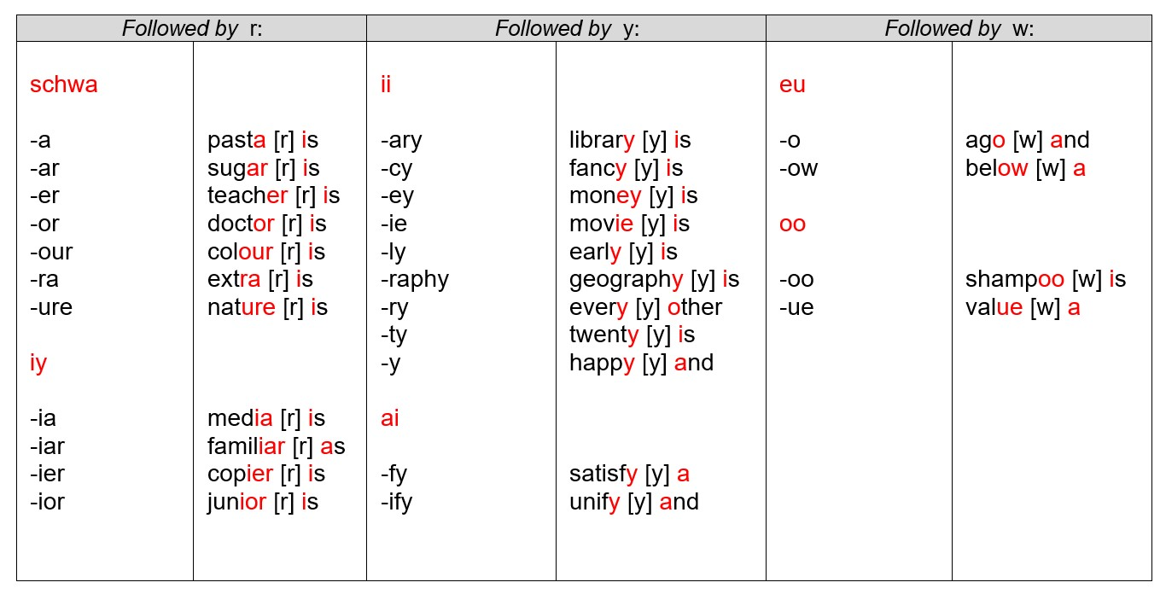

Slide 17
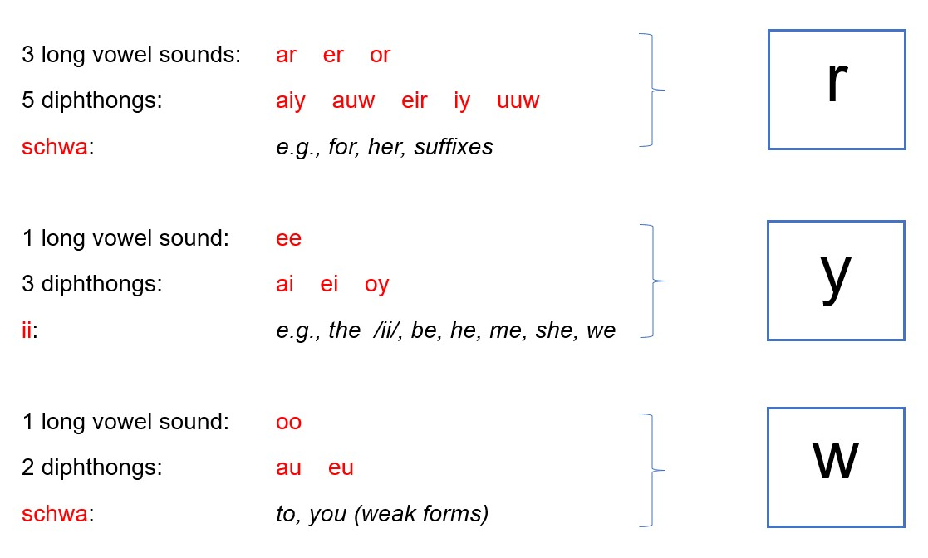
There are 23 vowel sounds in English. Here is a summary of which sounds meet r, y, and w:

Slide 18
6 out of 8 short vowel sounds cannot connect to other vowel sounds, because they do not appear at the end of a syllable next to another vowel sound:
a e i o u uu
The other 2 short vowel sounds – ii and schwa – can connect, as shown above. Note: the schwa sound is the only vowel sound that can connect with two sounds: r (‘teacher is’) and w (‘to Africa’). However, it more commonly connects with r.

Slide 19
As well as the connections below, it is a good idea to practice connections that repeat regularly. For example:

