Slide 1
Learn
Connected Speech
with Matt Purland

Slide 2
Believe in the power of connected speech!

Slide 3
A new 8-part English pronunciation course by Matt Purland

Slide 4
Lesson 6:
Deleting Sounds

Slide 5
Unit 6.5
Deleting duplicate sounds

Slide 6
4. Deleting duplicate sounds
The other time (4%) when we delete a sound is when there are two of the same sounds in a CC connection. In these cases, we delete the first sound. The result in each case is a VC or friendly connection.
For example:
tell Lena >> te Lena no glottal stop
dance solo >> dan solo no glottal stop – friendly con.

Slide 7
We do not add a glottal stop with voiced consonant sounds, e.g.
bag grab >> ba grab
We add a glottal stop when the sounds are unvoiced k, p, and t:
quick coffee >> qui_ coffee glottal stop
keep product >> kee_ product glottal stop
heat timer >> hea_ timer glottal stop

Slide 8
We do not need to pronounce both sounds because our brains register both words, without having to hear every consonant sound. We delete the first sound because it is very difficult for us to pronounce both consonant sounds together in a CC connection. It is possible, but it is awkward.
Duplicate sounds occur fairly rarely – 4% of the time when deleting sounds, according to research – but we need to know what to do when it does happen. This only applies in CC connections. For VV connections, see Lesson 7.

Slide 9
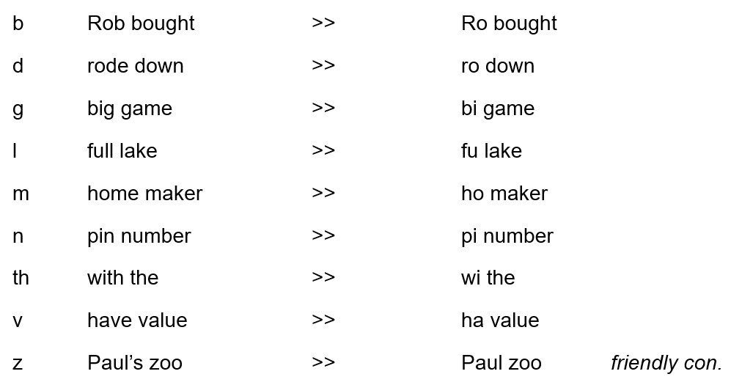
Practice with all possible voiced consonant sounds (no glottal stop):

Slide 11
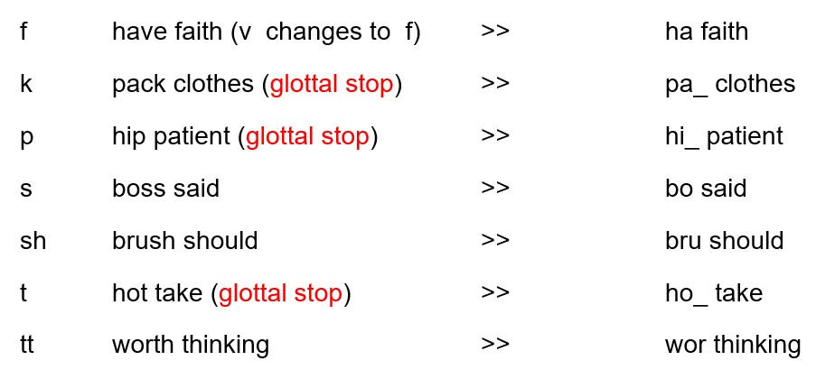
Practice with all possible unvoiced consonant sounds:

Slide 13
Practice: the first sound is deleted in CC connections
if there are duplicate sounds:
this session his zoo hit tale wash sheets gap pool
(CC) beneath theatre of fun wood door all ladies rob banks

Slide 14
Practice: the first sound is deleted in CC connections
if there are duplicate sounds:
site table rich chap black car shelf full fridge joke
(CC) said Dan save four fourth thought shrub border thick card

