Slide 1
Learn
Connected Speech
with Matt Purland

Slide 2
Believe in the power of connected speech!

Slide 3
A new 8-part English pronunciation course by Matt Purland

Slide 4
Lesson 6:
Deleting Sounds

Slide 5
Unit 6.4
Deleting h

Slide 6
3. Deleting h
This only occurs when the first sound in a pair is a consonant sound, and the second is h from one of these three function words: him, her, his – or variants himself and herself.
We delete h, creating a CV connection.

Slide 7
Then we have to move forward the consonant sound, to get a VC connection.
For example:
I gave him a book. >> I ga vi ma book.
He made her some soup. >> He ma der some soup.
I bought his car. >> I bor ti scar.

Slide 8
As you can see, we sometimes need two or more actions to get the VC or friendly connection (Lesson 8).
When it comes to deleting sounds, we delete h 10% of the time, making it the third most common sound to delete, after t and d. It does not happen very often, but it can happen.

Slide 9
We do it to make the function words him, her, and his sound weaker. In turn this makes the stressed syllables sound stronger – emphasising the sound spine. There is no mountain without the valleys! Function words are the weak-stressed ‘valleys’ and must be reduced rather than pronounced loudly with equal stress to content words:
him >> im
her >> er a schwa sound; sounds like article ‘a’
his >> iz

Slide 10
If you put stress on them – by pronouncing ‘h’ + a strong vowel sound – we may have problems identifying the strong syllables which should have the strong vowel sounds. In short, it messes up the sound spine (Lesson 1).
Deleting h from the beginning of these function words is acceptable in Standard English. The trick is to do it in fast speech so that the listener is unaware of the ‘h’ being dropped.

Slide 11
Some native speakers of English take the deletion of h further and delete it from many or even every word beginning with the letter ‘h’.
For example:
I’ll ’ave an ’oliday in ’arrogate with ’elen.
(I’ll have a holiday in Harrogate with Helen.)
What ’appened at the ’ospital, ’arold?
(What happened at the hospital, Harold?)

Slide 12
This is much more noticeable. The deletion is pronounced in an obvious way and not hidden in fast speech. It is very common in many accents and dialects of English, e.g., Estuary English, which is most associated with London and the area around the Thames Estuary.
It is not considered standard English, so we do not focus on it during this course.
Of course, a few common English words beginning with the letter ‘h’ already have the ‘h’ dropped in pronunciation. For example: heir, homage, honest, honour, and hour.

Slide 13
h is usually spelled: ‘h-’:
h is spelled ‘wh-’ in a few words, including: ‘who’, ‘whom’, ‘whoever’, ‘whose’, ‘whole’, ‘wholesale’, ‘wholesome’, and ‘wholly’.

Slide 14
There are five high-frequency words beginning with h in the 100 Most Common Words in Written English list. We can discount the first two – ‘have’ (9) and ‘he’ (16) – because we normally pronounce the h in these words.
We delete the h in the other three words, though: ‘his’ (23), ‘her’ (29), and ‘him’ (58).

Slide 15
I do not want to be too prescriptive, because it may be that, in fast speech, other function words beginning with h may be deleted too. For example:
I said he just left. >> I sai de ju sleft.
However, we should be careful not to overdo the deletion of h, because then we may move away from Standard English towards accent, dialect, and slang.

Slide 16
A note about deleting h and t:
As described above, when t meets another consonant sound, we delete it and add a glottal stop. For example:
I got him a new bike. >> I go_ him a new bike.

Slide 17
With the words him, her, and his, however, this rule is ignored, because we can delete the h and move forward the t. It sounds more fluent:
I go ti ma new bike.
Here are more examples with her and his. Further contractions may also be possible:
I wan_ her to stay. >> I wan ter to stay. >> I wanna to stay.
I pu_ his cake there. >> I pu ti sca kthere. >> I pudis ca kthere.

Slide 18
VC Connections:
In fast speech, we may also delete the h at the beginning of him, her, his, himself, and herself in VC connections. This creates a VV connection (Lesson 7). We delete the h then add w, y, or r:
show him >> show [w] im + w
buy his >> buy [y] iz + y
saw her >> saw [r] + r
However, this is moving away from Standard English. It is not normally necessary to alter a VC connection (Lesson 2).

Slide 19
Practice: h is deleted at the beginning of a syllable in
CC connections, then the first consonant moves forward:
ask her get herself tell him teach himself book his
(CC) like herself drive his read her put him question himself

Slide 20
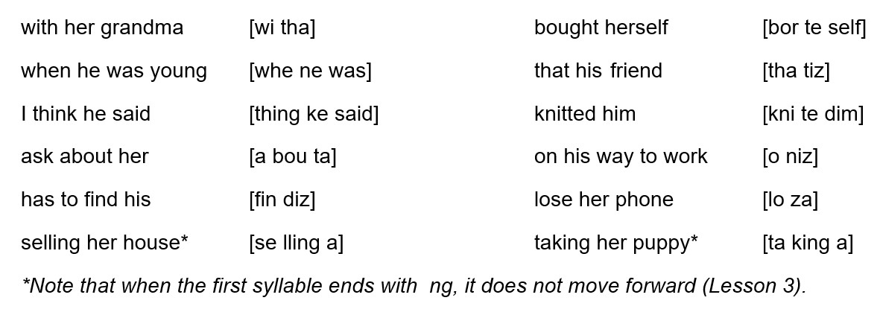
Practice deleting h and moving forward in these short phrases:

