Slide 1
Learn
Connected Speech
with Matt Purland

Slide 2
Believe in the power of connected speech!

Slide 3
A new 8-part English pronunciation course by Matt Purland

Slide 4
Lesson 6:
Deleting Sounds

Slide 5
Unit 6.2
Deleting t

Slide 6
1. Deleting t
The most common sound to delete is t, which accounts for 62% of our deleted sounds.
While t moves forward in a CV connection – e.g., ‘get in’ >> ‘ge tin’ (Lesson 4) – we always delete t when it occurs at the end of a syllable and the next sound is a consonant.

Slide 7
We replace t with a glottal stop, represented by _ when t is deleted next to a vowel sound or friendly consonant sound For example:
bat cover >> ba_ cover
fit person >> fi_ person
went home >> wen_ home
got mail >> go_ mail

Slide 8
We delete t because it is difficult for us to pronounce it next to another consonant sound. It would create a noticeable gap between syllables, which is what we are trying to avoid.
Using a glottal stop allows us to hear and acknowledge the missing t, without pronouncing it. Without the glottal stop the phrase may sound meaningless. For example, compare ‘fi_ person’ with ‘fiperson’.

Slide 9
Without a glottal stop we may end up with a different phrase altogether. For example:
‘great weekend’ >> delete t >>
with a glottal stop = ‘grea_ weekend’
without a glottal stop = ‘grey weekend’

Slide 10
It may look like we hate t in spoken English, since we delete it every time it appears in CC connections. It is unfortunate, then, that t is such a common sound in English. It is the final sound of no fewer than thirteen one-syllable high-frequency words in the 100 Most Common Words in Written English list:

Slide 11
*We can also include common negative auxiliary forms which are contractions of ‘not’, for example: ‘don’t’, ‘doesn’t’, ‘didn’t’, ‘won’t’, ‘haven’t’, etc.

Slide 12
As a final consonant sound, t is pretty much everywhere in English. It appears at the end of a syllable in most sentences, and when the connection is CC, t is deleted and replaced by a glottal stop.

Slide 13
The t sound can be spelled in six different ways at the end of a syllable, but the most common is simply with ‘-t’:

Slide 14
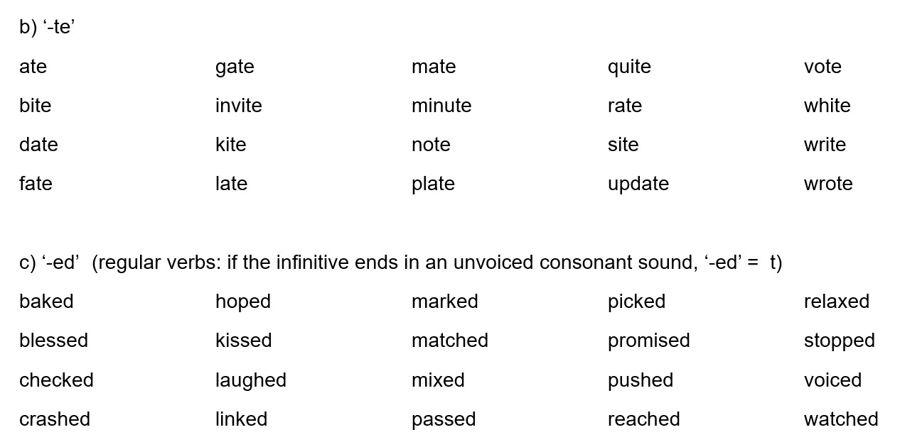
The other ways of spelling t are: ‘-te’, ‘-ed’, ‘-ght’, ‘-tt’, and ‘-bt’:

Slide 16
In addition to common words ending with t, there are also many common suffixes which end in t. For example:
As we saw in Lesson 3, there are several common suffixes where, when we delete t at the end, we can rest on the friendly consonant sound n plus glottal stop. For example: -ant, -ent, -iant, -ient, and -ment.

Slide 17
This is also true of common words ending in ‘-nt’ and ‘-lt’. For example:
content panel >> conten_ panel
point was >> poin_ was
felt good >> fel_ good
salt cellar >> sal_ cellar

Slide 18
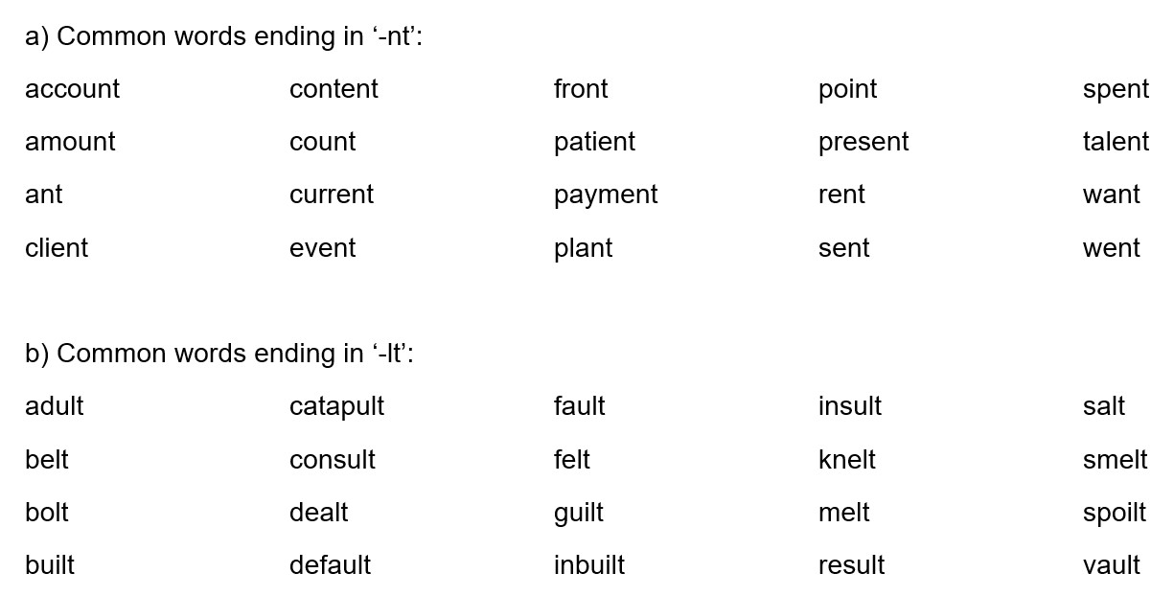

Slide 19
c) Common words ending in ‘-mt’:
There is only one common word ending in ‘-mt’: ‘dreamt’.
These days it is more usual to use the regular ‘-ed’ spelling: ‘dreamed’.
There are no English words ending in ng + t.
(See Lesson 3.)

Slide 20
Practice: t is deleted and replaced by a glottal stop in CC connections:
(CC) get the at seven airport to flight was hit by
(CC) that door at the what day eight will get there

Slide 21
Practice: t is deleted and replaced by a glottal stop in CC connections:
(CC) about that start uni get married without my debit card
(CC) meet you don’t like haven’t got important to suit which

