Slide 1
Learn
Connected Speech
with Matt Purland

Slide 2
Believe in the power of connected speech!

Slide 3
A new 8-part English pronunciation course by Matt Purland

Slide 4
Lesson 5:
Moving Forward – Part 2

Slide 5
Unit 5.8
l

Slide 6
l (1%)
l is the third most common friendly consonant sound at the end of a syllable, after n, and ng. The sound l can be spelled in four different ways – musical, will, whistle, and Elle – but by far the most common way is ‘-l’.
The other spellings all include silent letters. Though voiced, l does not form part of a consonant pair, so it does not change moving forward.

Slide 7
Common suffixes ending in l include:
-al, -eal, -el, -ial, -le, -ol, -ple, -tal, -ual, -ule
There are three high-frequency words ending in l in the 100 Most Common Words in Written English list: will / ’ll (33), all (36), and well (89).
Other common words that end in l include:

Slide 8
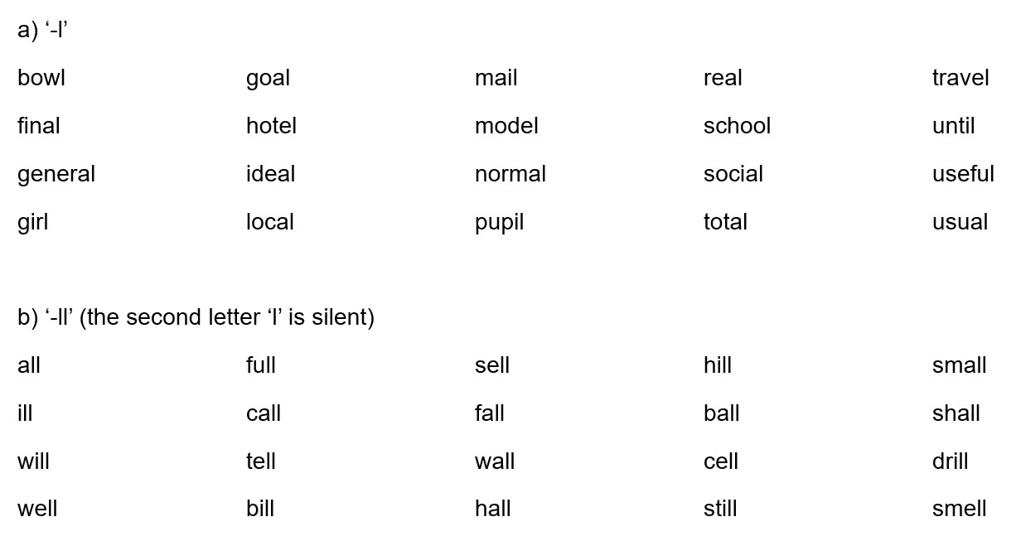

Slide 10
Practice: l only moves forward in CV connections
tell us hole in bowl of boil it sell a
(CV) fall over middle of mile and people in style of

Slide 11
l remains in CC connections, creating good sound connections
as a friendly consonant sound:
oil drum call me goalkeeper braille book whole day
(CC) social media all night school bag well done male nurse

Slide 12
ng (0%)
ng does not move forward in CV or CC connections.

