Slide 1
Learn
Connected Speech
with Matt Purland

Slide 2
Believe in the power of connected speech!

Slide 3
A new 8-part English pronunciation course by Matt Purland

Slide 4
Lesson 5:
Moving Forward – Part 2

Slide 5
Unit 5.7
m

Slide 6
m (1%)
m is the fourth and least common friendly consonant sound at the end of a syllable, after n, ng, and l. The sound m can be spelled in seven different ways – platform, home, programme, comb, palm, hymn, and hmm – but by far the most common way is ‘-m’. The other spellings all include silent letters.
Though voiced, m is a friendly consonant sound and does not form part of a consonant pair, so it does not change moving forward.

Slide 7
Common suffixes ending in m include:
-com, -dom, -im, -ism, -ium, -um, -some, -um
There are six high-frequency words ending in m in the 100 Most Common Words in Written English list: from (25), time (55), him (58), some (66), them (68), and come (76).
Apart from the frequent function words ‘I’m’ and ‘am’, other common words that end in m include:

Slide 8
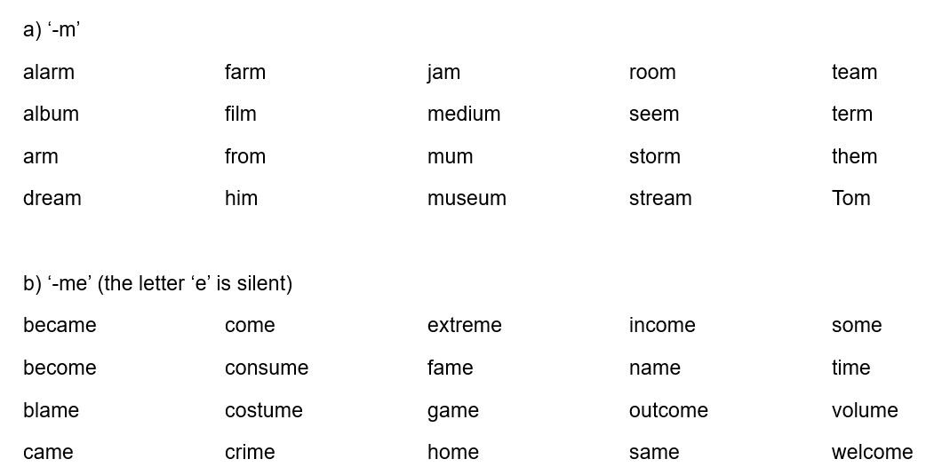

Slide 9
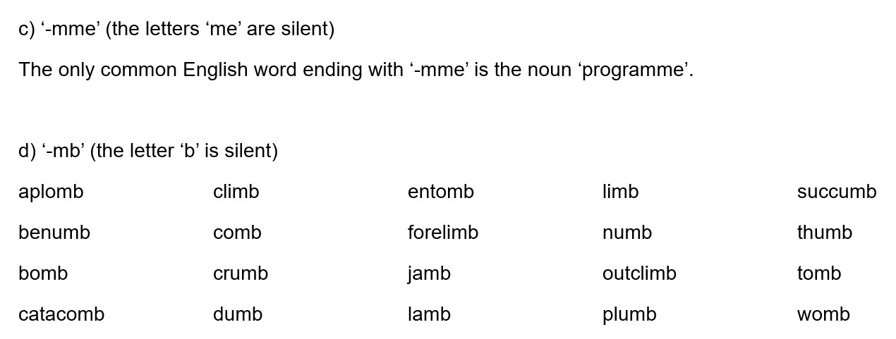

Slide 11
Practice: m only moves forward in CV connections
(CV) climb up autumn is mum allows balm and hymn eight
(CV) crumb of come inside calm us poem about arm ache

Slide 12
m remains in CC connections, creating good sound connections
as a friendly consonant sound:
Pam said medium roast dumb thing mum was seem to
(CC) jam for condemn him comb your lamb chop some guys

