Slide 1
Learn
Connected Speech
with Matt Purland

Slide 2
Believe in the power of connected speech!

Slide 3
A new 8-part English pronunciation course by Matt Purland

Slide 4
Lesson 5:
Moving Forward – Part 2

Slide 5
Unit 5.4
th / tt

Slide 6
th (2%) / tt (1%)
This is the only consonant pair that can be spelled the same: ‘-th’.
We can also spell the voiced th sound with ‘-the’, as in ‘bathe’. The unvoiced tt sound is always spelled with ‘-th’ in English.
There is one word ending in th in the 100 Most Common Words in Written English list: ‘with’, at number 15. There are no words in this list ending in tt.

Slide 7
The two ‘th’ sounds in English can be tricky to pronounce, but it is well worth trying to learn them. Just like learning to make glottal stops, the ‘th’ sounds can be mastered with some practice.
You will need to spend some time in front of a mirror sticking your tongue out between your teeth for half a second at a time!
You will find some material about both topics here:
Glottal Stops
The ‘th’ Sounds in English

Slide 8
In general, words ending in th seem to be more obscure than words ending in tt. There aren’t many common words ending in the sound th, the most common of which is, of course, ‘with’.
There are not a great many words ending in tt either, so it is no surprise that this pair is so low down our ranking. Having said that, all ordinal numbers end with tt – like ‘fourth’, fifth’, and ‘sixth’ – except for numbers ending with 1st, 2nd, and 3rd.

Slide 9
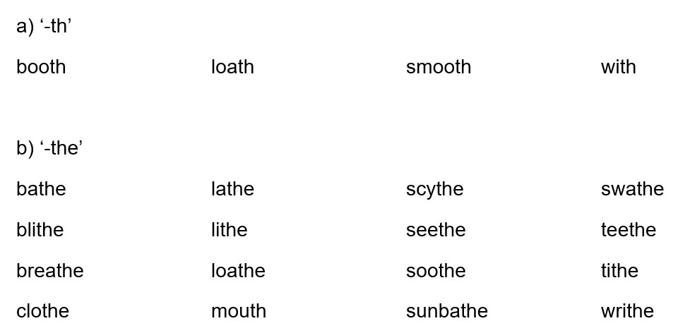
Here are some examples of words ending in th:

Slide 10
Here are some examples of common words ending in tt:

Slide 11
Practice: th / changes to tt in CC connections
(CV) with a swathe of lithe as seethe about bathe in
(CC) smooth skin soothe James tithe for booth which mouth to

Slide 12
tt does not change in CV and CC connections:
growth is both of faith in teeth are width of
(CC) earth day bath time mouth was health centre north pole

