Slide 2
20 Phrasal Verbs with GO
Link to download the free resources: https://purlandtraining.com
Images: https://pixabay.com/

Slide 3
GO AFTER
GO AGAINST
GO AHEAD
GO ALONG
GO AWAY

Slide 4
How natural is your English?
Did you learn phrasal verbs at school?
If not, why not?

Slide 5
GO BACK
GO BEFORE
GO BY
GO DOWN
GO FOR

Slide 6
How many phrasal verbs are there?
How can I learn phrasal verbs?
What resources are there?

Slide 7
GO IN
GO OFF
GO ON
GO OUT
GO OVER

Slide 8
Should I bother learning phrasal verbs?
Are they formal or informal?
Why do native speakers prefer them?

Slide 9
GO THROUGH
GO UNDER
GO UP
GO WITH
GO WITHOUT

Slide 10
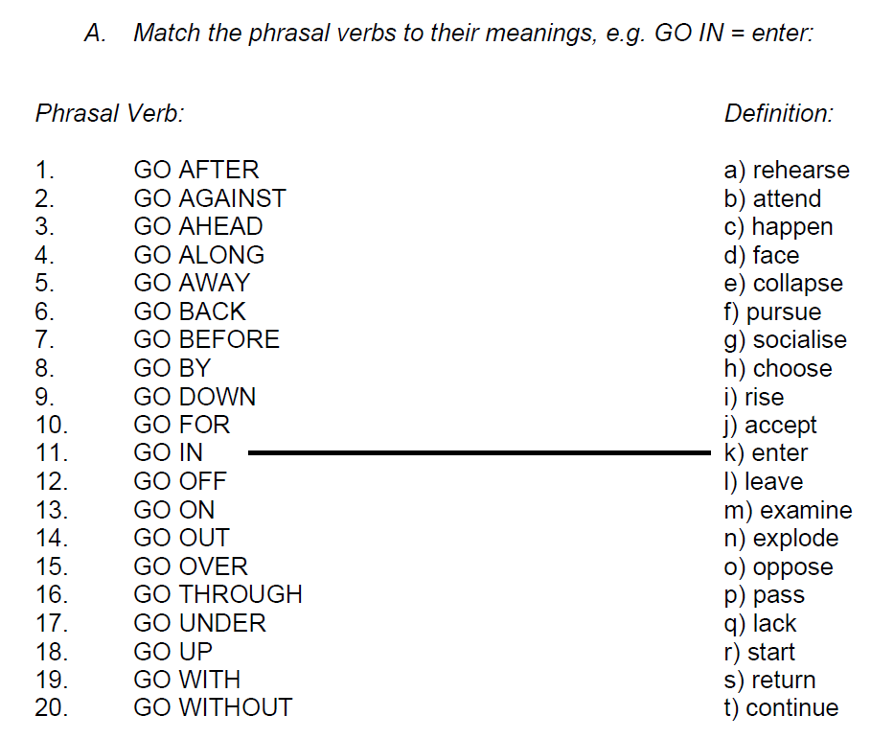
Exercise A:

Slide 11
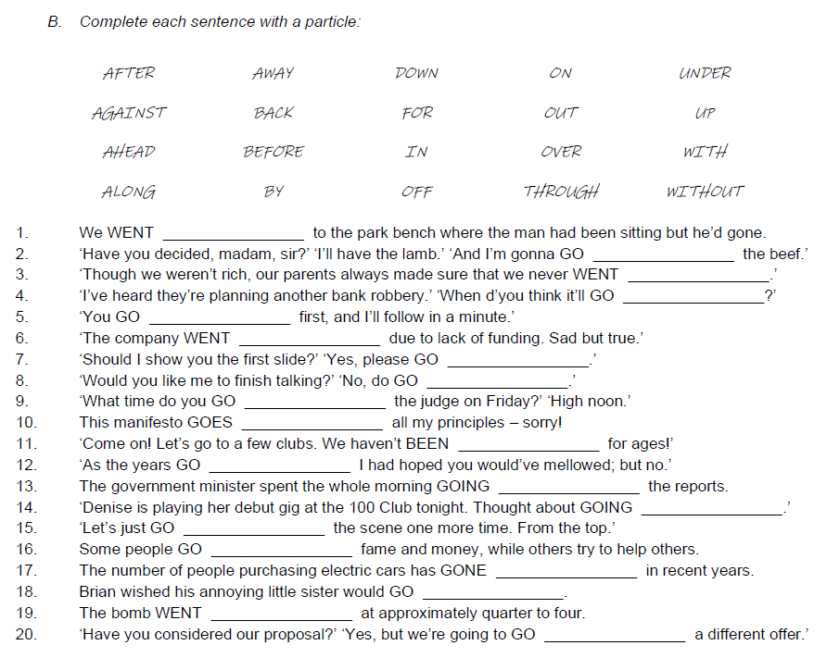
Exercise B:

Slide 12
Further Suggestions:

Slide 13
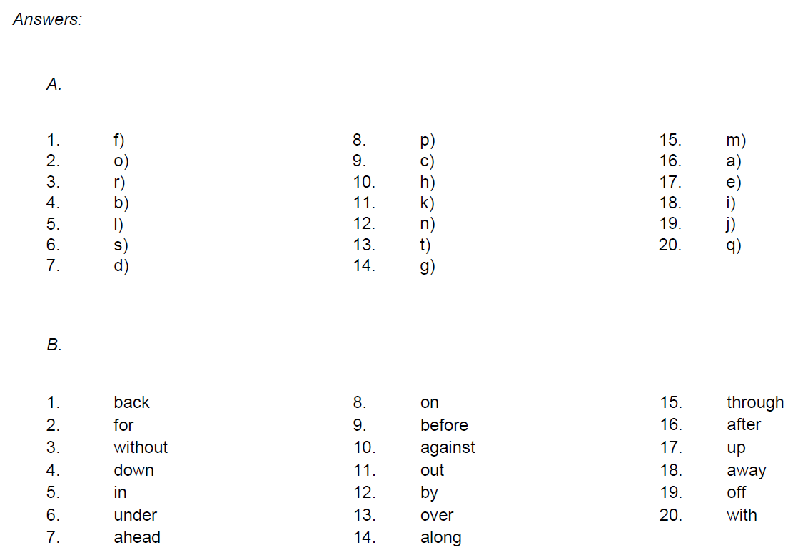
Answers:

