Slide 1
Learn English Pronunciation Now!
Useful Links:
Talk a Lot Spoken English Course:
https://purlandtraining.com/free-books/
Free Spoken English Handbook:
https://purlandtraining.com/free-books/free-talk-a-lot-elementary-handbook-by-matt-purland/
The 48 Sounds of English with the IPA:
https://purlandtraining.com/wp-content/uploads/2016/10/clear-alphabet-chart.pdf
https://purlandtraining.com

Slide 3
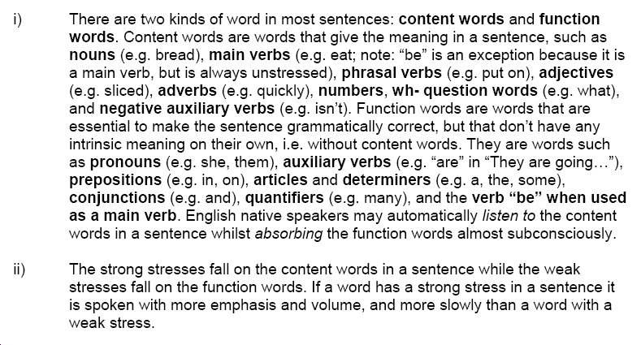

Slide 6
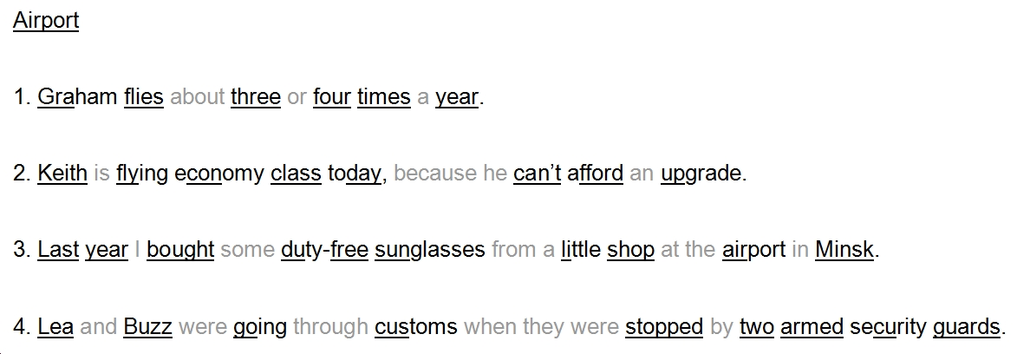

Slide 8
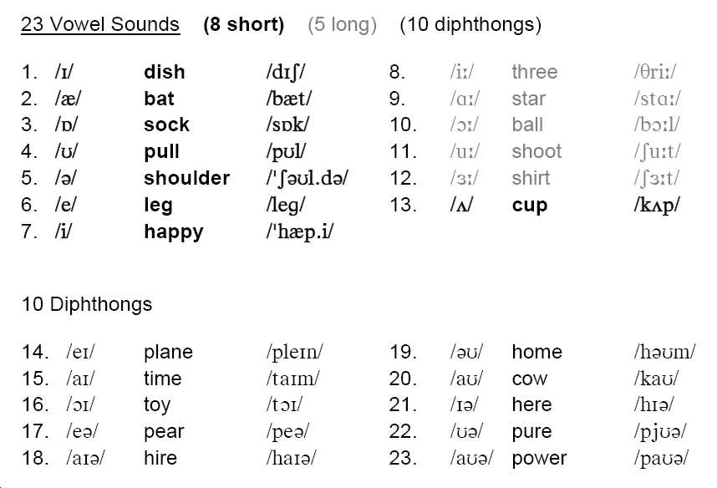

Slide 9
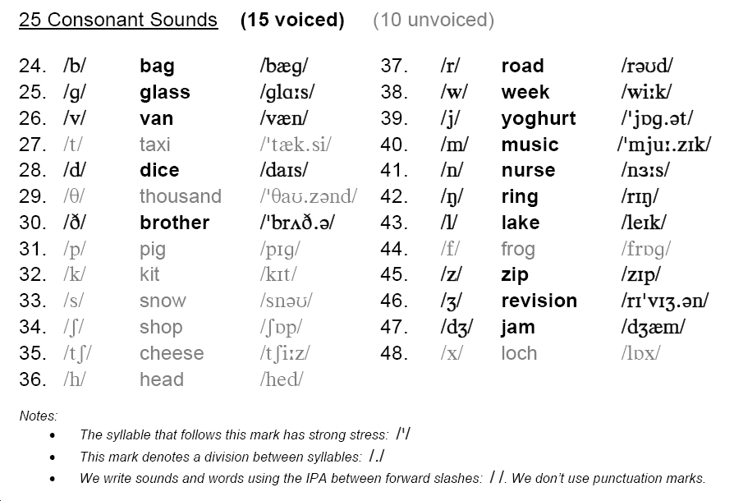

Slide 10
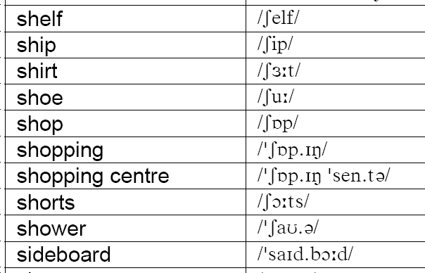

Slide 11
