Slide 1
Before we start:
Please don’t take my speech during these lessons as a model of good
pronunciation!
I’m deliberately speaking more slowly than my normal speed, so that
you can understand me more easily.
https://purlandtraining.com

Slide 2
English Pronunciation Workshop – So Far…
English is not a phonetic language. English spelling doesn’t help you with pronunciation.
English is a stress-timed language.
There are 48 sounds in English, but only 26 letters.
There are 23 vowel sounds in English, but only 5 vowel letters.
The vowel sound on the strong stresses are the most important sounds in a sentence.

Slide 3
Hypothesis
Even with the stress and vowel sounds correct in a sentence, we can
still sound incorrect, because the words are not connected together.
But – English words don’t fit together well. They are badly-made puzzle
pieces.

Slide 4
Hypothesis
We use connected speech techniques to flatten out the irregularly
shaped words so that they fit the “vc” (vowel-consonant) pattern.
CV CV CV CV CV CV CV CV CV CV CV, etc.
So the perfect syllable unit is: CV, e.g. the, so, she, they, to, etc.
ma ma ma ma ma ma ma ma ma ma ma ma, etc.
It’s the difference between writing by printing each letter separately, or
using joined-up handwriting. Everybody can read and understand
printed letters (e.g. type in a book or on a screen), but not everybody
can read joined-up handwriting.

Slide 5
A typical example of spoken English
Simon Ponsonby is a native speaker of English from Bristol in the UK.
He is Pastor of Theology at St. Aldate’s Church in Oxford, UK.
He was speaking to a large group of native speakers at a service on
14th November 2010. He was speaking naturally, but fairly clearly,
because he wanted to be understood by the group.

Slide 6
Example Sentence 1
In a recent survey by fool.co.uk – you can check it yourself – they
asked fifteen hundred adults about money…
Normal speed: Slowed down:

Slide 7
Example Sentence 1 – syllable by syllable
In a re cent sur vey by fool dot co dot you kay – you can check it
your self – they asked fi fteen hun dred a dults a bout mo ney…

Slide 8
Example Sentence 1 – syllable by syllable
In a re cent sur vey by fool dot co dot you kay – you can check it
your self – they asked fi fteen hun dred a dults a bout mo ney…

Slide 9
Example Sentence 1 – how he says it
In a re cent sur vey by fool dot co dot you kay – you can check it
I na re sen sur vey by fool do co do you kay – you cun che ki
your self – they asked fi fteen hun dred a dults a bout mo ney…
yu sewf – they ars fi fteen hun dre da duw su bou mu ney.

Slide 10
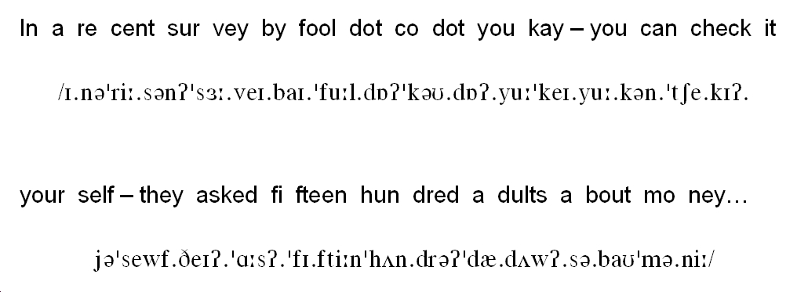
Example Sentence 1 – with the IPA

Slide 11
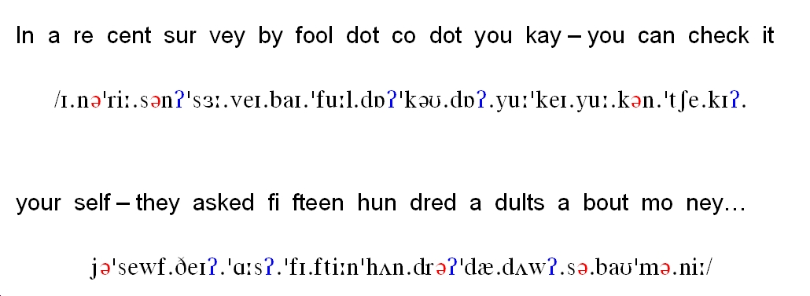
Example Sentence 1 – schwa sounds and glottal stops

Slide 12
Example Sentence 1 – summary
8 seconds
17 words
31 syllables
7 schwa sounds
8 glottal stops

Slide 13
Summary of what typically happens:
VC = syllables connect together smoothly
CV = linking – the consonant sound from the end of the first syllable
becomes the first sound of the next syllable
VV = intrusion – a new sound appears – /j/, /w/, or, /r/
CC = elision – /t/ and /d/ disappear from the ends of words and are replaced by glottal stops. Assimilation means that a consonant sound changes so that it fits better and is easier to say. This is fine because the most important sounds in the sentence are the vowel sounds on the stressed syllables – and these are unchanged by what happens to the consonants around them.

Slide 14
Procedure
Find or write a short sentence (8-10 words)
Check for understanding
Separate content and function words
Identify stressed syllables on the content words
Write the vowel sounds on the stressed syllables
Look for schwa sounds and weak forms in the function words
Write the sound connections between syllables: vc, cv, vv, or cc
Use the techniques of connected speech to create vc connections
Practice reading – slowly at first, then getting faster!

Slide 15
Techniques of Connected Speech

Slide 16
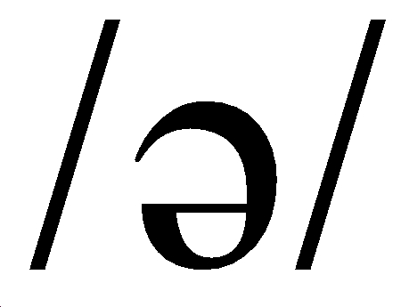
The Schwa sound

Slide 17
The Schwa sound in English
From Wikipedia:
Schwa is a very short neutral vowel sound
Schwa is an unstressed and toneless neutral vowel sound in some languages
Quite a few languages have a sound similar to schwa
http://en.wikipedia.org/wiki/Schwa
From BBC Learning English:
Schwa is the name for the most common sound in English. It is a weak, unstressed sound and it occurs in many words. It is often the sound in grammar words such as articles and prepositions
Getting the schwa sound correct is a good way of making your pronunciation more accurate and natural
http://www.bbc.co.uk/worldservice/learningenglish/grammar/pron/features/schwa/

Slide 18
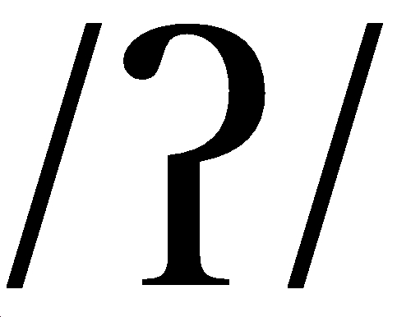
The glottal stop

Slide 19
The glottal stop in English
From Encyclopaedia Britannica:
A momentary check on the airstream caused by closing the glottis (the space between the vocal cords) and thereby stopping the vibration of the vocal cords. Upon release, there is a slight choke, or cough-like explosive sound. The glottal stop is not a separate phoneme (or distinctive sound) in English, though it is one of the allophones of the t phoneme in some dialects (as in Cockney or Brooklynese “bo’l” for “bottle”).
http://www.britannica.com/EBchecked/topic/235680/glottal-stop
From Wikipedia:
In English the feature is represented for example by the hyphen in uh-oh!
It is produced by obstructing airflow in the vocal tract.
It is called the glottal stop because the technical term for the gap between the vocal folds, which is closed up in the production of this sound, is the glottis.
http://en.wikipedia.org/wiki/Glottal_stop
From Teaching English (British Council and BBC):
Many languages use glottal stops, often much more than in English.
Few learners have difficulty producing the glottal stop sound but they can have problems understanding words that can be pronounced with it in certain accents, like bottle and butter. http://www.teachingenglish.org.uk/think/knowledge-wiki/glottal-stop
Q. When is a sound not a sound?
A. When it’s a glottal stop!

Slide 20
Practice connected speech with Talk a Lot

Slide 21
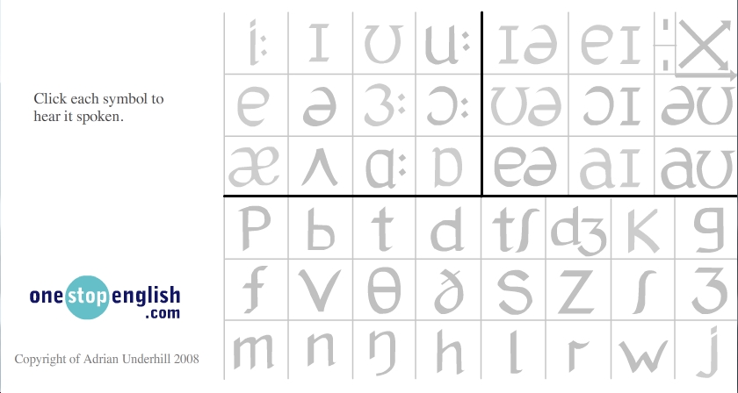
Interactive Phonemic Chart (download .swf file)
http://www.onestopenglish.com/section_flash.asp?catid=60030
Also: http://www.teachingenglish.org.uk/try/activities/phonemic-chart

