Slide 1
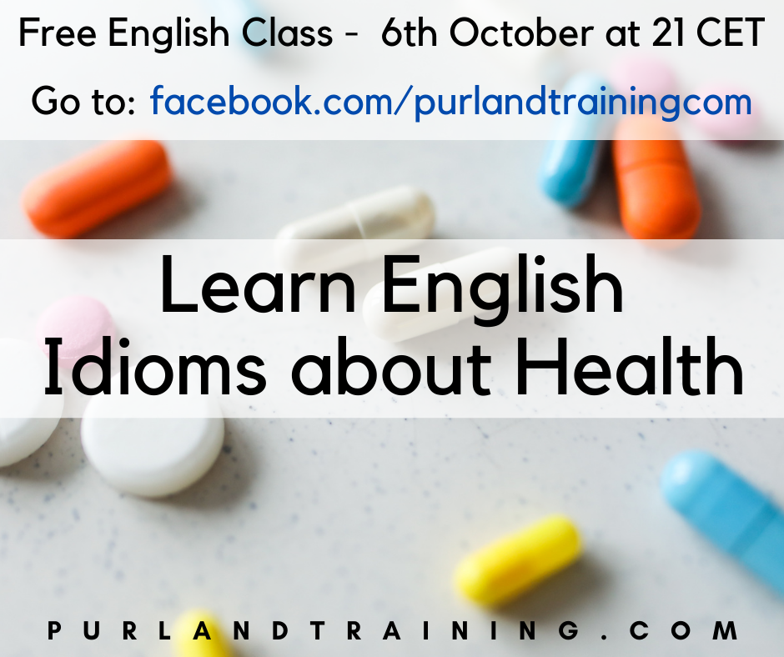

Slide 2
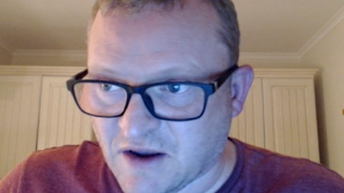
Matt Purland
PurlandTraining.com

Slide 3
Please FOLLOW and
tell your friends! :)
https://purlandtraining.com
https://www.facebook.com/purlandtrainingcom
https://tiny.cc/ptyt (YouTube: Purland Training)
https://twitter.com/purlandtraining
https://www.twitch.tv/learnenglishnow

Slide 4
FREE Live English Class
Topic: Learn English Idioms about Health

Slide 5
What is an idiom?
An established expression whose meaning is not deducible from the literal meanings of its component words, often peculiar to a given language.
en.wiktionary.org
It’s raining cats and dogs. It’s raining heavily.

Slide 6
English Idioms about Health
An apple a day keeps the doctor away.
If you eat healthily you won’t need to see a doctor.
Be as fit as a fiddle.
Be very fit (and healthy). BORING / VANILLA
You are what you eat. JUNK IN > JUNK OUT
If you eat healthily, your body will be healthy.

Slide 7
English Idioms about Health
Be/feel under the weather
Not feel very well / be unwell
Call/Phone in sick
Call/Phone your workplace to report absence due to sickness
Be/feel as right as rain
Be/feel in perfect health

Slide 8
English Idioms about Health
Laughter is the best medicine (cliche) crass/insensitive
If you’re feeling down/depressed, it can be beneficial to have fun/have a good time/go out for a drink with friends
Get a clean bill of health
Get a new lease of life
Get back on your feet – hard time

Slide 9
English Idioms about Health
Have/have got a frog in your throat visual phrases
I have a problem speaking at the moment
Have/have got one foot in the grave
You’re on the way out
You’re dicing with death
Be just what the doctor ordered
It’s just what I wanted

Slide 10
https://purlandtraining.com/free-books/

Slide 11
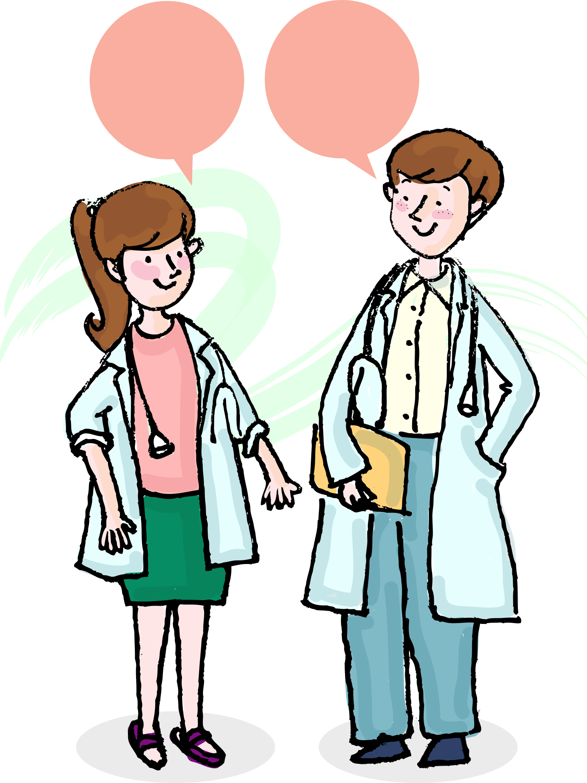
Join me next time at 21 CET
for a FREE LIVE English class
here on Facebook Live!
https://purlandtraining.com
https://www.facebook.com/purlandtrainingcom
https://tiny.cc/ptyt (YouTube: Purland Training)
https://twitter.com/purlandtraining
https://www.twitch.tv/learnenglishnow

