Slide 1
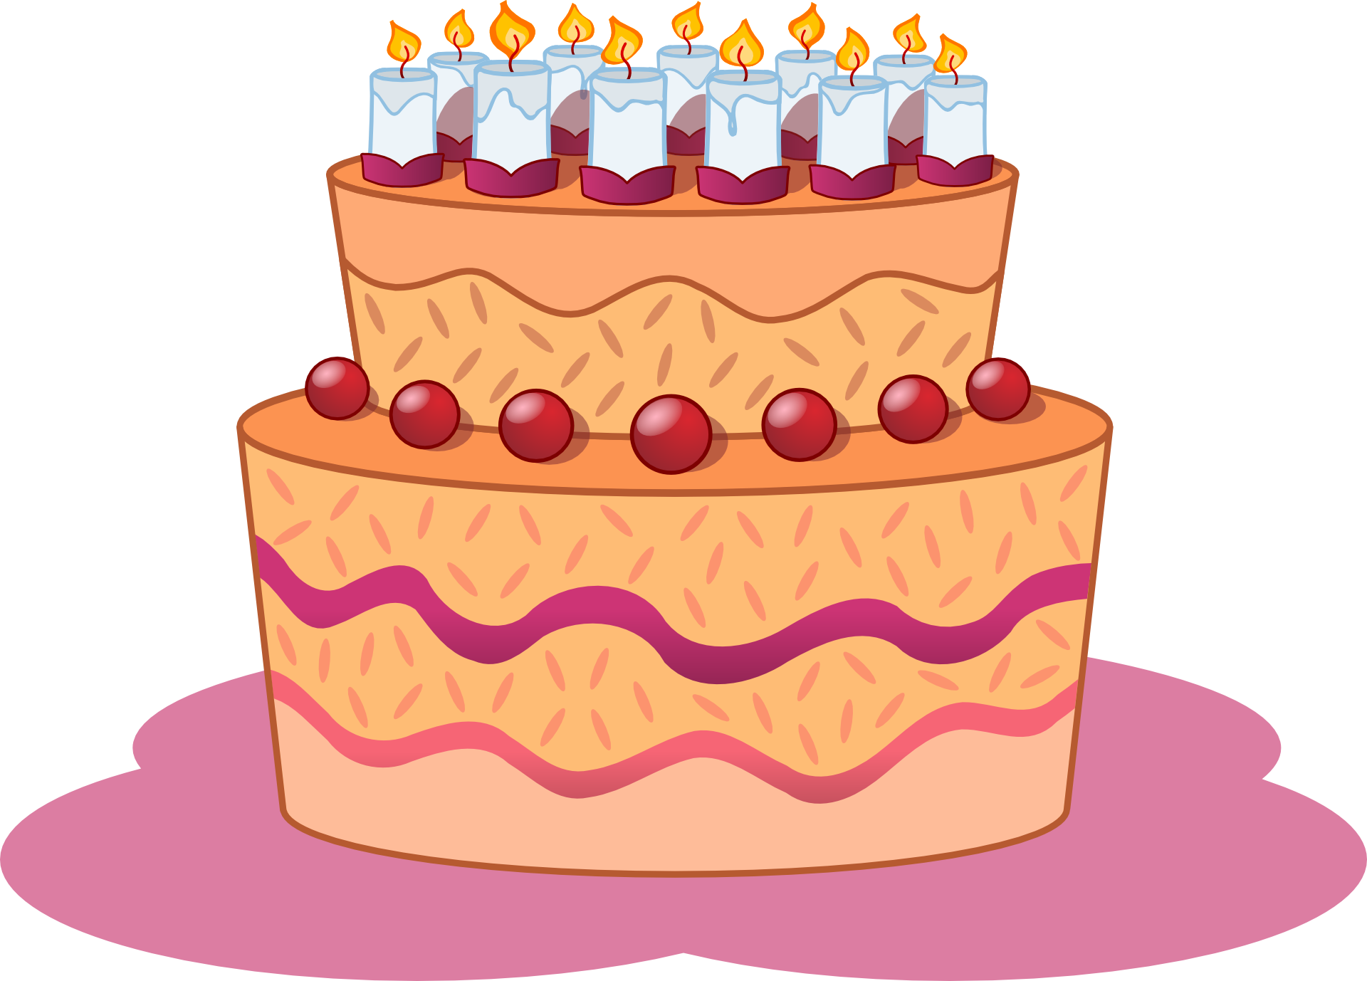

Slide 2


Slide 3


Slide 4


Slide 5
How to Pronounce “th” Sounds in English
With Matt Purland
Website: https://purlandtraining.com
E-mail: info@purlandtraining.com
Twitch: LearnEnglishNow
Twitter: https://twitter.com/purlandtraining
Facebook: https://www.facebook.com/purlandtrainingcom/
Source: Talk a Lot Elementary Handbook, pp.283-294
https://purlandtraining.com/free-books/free-talk-a-lot-elementary-handbook-by-matt-purland/

Slide 6
How to Pronounce “th” Sounds in English

Slide 7
How to Pronounce “th” in English
What are the “th” sounds in English?
Why are they so difficult to pronounce?
How can I pronounce the “th” sounds in English?

Slide 8
What are the “th” sounds in English? (Page 1)
“th” is a digraph – two letters together that represent one sound.
“th” can also be called a consonant cluster – two consonants together in the spelling of a word.
A “th” digraph can come at the beginning of a word, e.g. “think” and “though”, in the middle of a word, e.g. “author” and “clothe”, or at the end of a word, e.g. “wealth” and “with”. Or in a combination, e.g. “thousandth”.
“th” can signify either of two different phonemes (single sounds) in English. It can be either: /T/ in “thick” and “thin”, or /D/ in “this” and “that”.
The /T/ sound is unvoiced. This means that when I make this sound, no sound is heard from my vocal chords. There is no vibration in my throat because my vocal chords do not vibrate. Try putting your fingers over your throat when you make this sound. You shouldn’t feel your vocal chords vibrating.

Slide 9
What are the “th” sounds in English? (Page 2)
The /D/ sound is voiced. This means that when I make this sound, a sound is heard from my vocal chords. There is vibration in my throat. Try putting your fingers over your throat when you make this sound. You should feel your vocal chords vibrating gently.
“th” very occasionally represents a /t/ sound, especially in names, e.g. Thames, Thailand, Esther, Thandie, Theresa, Thompson, thyme, apartheid.
English words that have the /T/ sound are generally content words. For example, nouns (like “thief”, “thumb”, “tooth”, and “wealth”), verbs (like “thank”, “think”, and “throw”), adjectives (like “thirsty”, “thermal”, and “thoughtful”), adverbs (like “thoroughly”, “thankfully”, and “threateningly”), and numbers (like “three”). Most ordinal numbers contain the /T/ sound, for example, “fourth”, “fifth”, and sixth”.

Slide 10
What are the “th” sounds in English? (Page 3)
English words that have the /D/ sound are generally function words. For example, pronouns (like “their”, “theirs”, “them”, and “themselves”), determiners (like “this”, “that”, “these”, and “those”), conjunctions (like “though”), the preposition “with”, and time words, (like “then”, and “thereafter”). All comparative phrases contain the /D/ sound, thanks to the word “than” being included after the comparative adjective, e.g. “stronger than”.
As you can see, many very common words in English contain one or other of these sounds. A good example is the definite article “the”, which is so ubiquitous (“Article before a noun!”) that it can be heard in almost every sentence in English.
Word frequency lists: “Based on an analysis of the Oxford English Corpus of over a billion words, and represents one study done by Oxford Online, associated with the Oxford English Dictionary.”
There are twelve “th” words in the top 100 English words:

Slide 11
What are the “th” sounds in English? (Page 4)
1 – the (definite article), 8 – that, 15 – with, 21 – this, 26 – they
38 – there, 39 – their, 70 – other, 71 – than, 72 – then, 79 – think,
96 – these
So /D/ is more common than /T/.
http://en.wikipedia.org/wiki/Most_common_words_in_English
Out of the 220 Dolch words + 95 nouns, there are 21 “th” words. 15 have the /D/ sound, and only 6 have the /T/ sound:
the, three, that, there, they, this, with, thank, them, then, think, both, their, these, those, together, birthday, brother, father, mother,
thing
http://en.wikipedia.org/wiki/Dolch_Word_List
Try this exercise: take any page of a novel or textbook, count the number of lines, then count how many lines don’t have a word with “th” in the spelling. I found approx. 8/37 lines – most often the word with “th” was “the”.

Slide 12
Why are they so difficult to pronounce? (Page 1)
These phonemes (sounds) don’t exist in many languages, e.g. Chinese, Vietnamese, and Polish. Where English native speakers learn them from their parents from before birth, ESL students have to start from scratch, cold. E.g. I can’t roll my r’s, but a native speaker of Polish can do it effortlessly. I have to learn to do it, or to “trick it”.
In many accents in English, e.g. teenagers’ street language, English native speakers don’t bother pronouncing “th”. They use substitute sounds, e.g. /f/ instead of /T/ , and /v/ instead of /D/ . For example:
fink = think, fanks = thanks
van = than, vem = them
In other versions of English around the world, people also substitute different sounds for /T/ and /D/. E.g. Irish English speakers tend to use /t/ instead of /T/ , and /d/ instead of /D/. For example:

Slide 13
Why are they so difficult to pronounce? (Page 2)
tink = think, tanks = thanks
dan = than, dem = them
And learners of English as a second language may automatically use substitute sounds if /T/ and /D/ are not native to their first language. They may use the sound combinations above, or /s/ instead of /T/ , and /z/ instead of /D/ . For example:
sink = think, sanks = thanks
zan = than, zem = them
What do you do to solve the problem of “th”?
We already know that /s/ and /z/ are among the easiest sounds to pronounce in English. The other substitute sounds above – /f/ and /v/, and /t/ and /d/ – are also much easier to pronounce than /T/ and /D/, which is why they are used.

Slide 14
Why are they so difficult to pronounce? (Page 3)
Vowel sounds are made when air passes freely from our lungs through our mouths and into the air. Consonant sounds are made when we restrict the flow of air through our mouths by using our tongue (often against our teeth) and altering the position of our mouths and lips.
The different combinations of vowel and consonant sounds when put together produce words that have fixed meanings that are shared by a group of people, e.g. all the speakers of any particular language.
Some consonant sounds are easier to make than others because the positions that our mouth and tongue have to form take less effort.
In the same way, some consonant sounds are more difficult to make than others because our mouth and tongue must move more: they must work harder. The two “th” sounds fall into this category. We need to move our tongue very quickly and put it out between our teeth, then put it back, just as quickly. We have to work!

Slide 15
Why are they so difficult to pronounce? (Page 4)
But if we use /f/, for example, instead of /T/, e.g. “fanks” instead of “thanks”, our tongue can have a holiday, because our lips form the /f/ sound, and our tongue doesn’t need to move.
“th” can be even more difficult to pronounce as a final digraph in combination with other consonant sounds. Here elision can be used, as seen when using the Connected Speech Templates from Talk a Lot Book 3.
For example:
fifth, sixth, thousandth, health, wealth, length, width, depth, etc.
Or we can just cheat and say “fif”, “helf”, etc.

Slide 16
How can I pronounce the “th” sounds in English? (Page 1)
In one sentence: put your tongue out between your teeth.
It can be learned. It is a physical action, like throwing a ball into a hoop (basketball), or mastering control of a bike, or learning to click your fingers…
Don’t block the flow of air through your teeth with your tongue. Allow some air to pass through above and below your tongue. Your teeth should be touching your tongue, but only very gently. Each time your tongue should be there for about one second, then return to its home position. (See photos and videos.)
With the /D/ sound, do the same as for the /T/ sound. The difference is that you must allow your vocal chords to vibrate.
Where are your vocal chords? See video here: Vocal Cords in Action http://www.youtube.com/watch?v=iYpDwhpILkQ
Practise in front of a mirror. Open up your mouth – see what’s going on. Or video yourself with a camera or phone. Practise with a friend. Help each other. Check what position the other person’s tongue, mouth, and lips are in. Practise with exercises:

Slide 17
How can I pronounce the “th” sounds in English? (Page 2)
try long slow breaths out: /T/ then /D/ then start to shorten them
ii) /T/ then /t/ then /D/ then /T/ again, and so on, for example:
th – t – th etc.
ii) read word lists out loud:
(see forthcoming lists of words sorted into categories…)
/T/ faith, thanks, wealth, three, both, thought, teeth, throughout
/D/ this, that, then, there, though, this, those, these
iii) lists of ordinal numbers:
fourth, fifth, sixth, thirty third, thirty seventh, thirty eighth, etc.
iv) say the word very slowly, sounding out each phoneme; use phonetic spellings to help you, e.g. /T I Î k/ and /D { t/

Slide 18
How can I pronounce the “th” sounds in English? (Page 3)
v) tongue twister sentences – either single sounds: /T/ …
Thrifty thirty-three year-old thrill seekers threatened pathetic lethargic therapists.
Three thick thieves from Thetford threw a party on Thursday.
Theo thanked Thora for enthusiastically thinking up a frothy mathematical method.
or /D/ …
Heather and Rutherford breathed blithely and clothed themselves with feather bathing suits.
The rhythm within withered further though Smithers writhed without.
The Worthington brothers tithed either their farthings or their clothes.

Slide 19
How can I pronounce the “th” sounds in English? (Page 4)
Or mixed sounds: /T/ and /D/ together:
This is the thing that Keith thought was thankless.
A thousand thirsty tourists threatened to take out their teeth.
Theresa tried to help both youths through the thick undergrowth.
The things that Theo thought, though truthful, were thoroughly thoughtless.
Arthur Worthington’s mother and father totally loathed withholding smooth scythes and seethed with oaths together.
Don’t worry about the meaning of each word, but simply practise the sounds! Try making up your own tongue twisters using the words from different word groups (nouns, verbs, etc.). You could use one or other of the sounds, or both sounds together.

Slide 20
Practice makes perfect!
Nobody is born able to make these sounds,
but everybody is born able to make these sounds
;)

