Slide 1
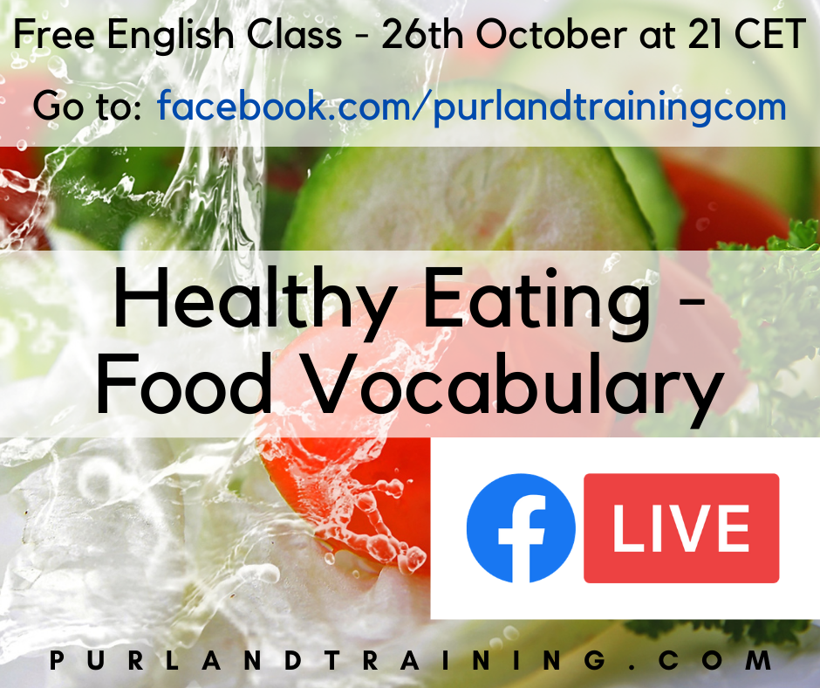

Slide 2
Tímea Kolberová Matt Purland
peira.english PurlandTraining.com

Slide 3
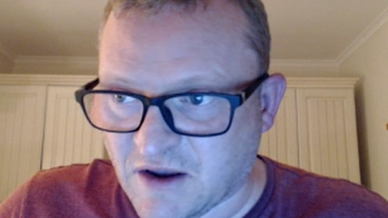
Please FOLLOW and
tell your friends! :)
https://purlandtraining.com
https://www.facebook.com/purlandtrainingcom
https://tiny.cc/ptyt (YouTube: Purland Training)
https://twitter.com/purlandtraining
https://www.twitch.tv/learnenglishnow

Slide 4
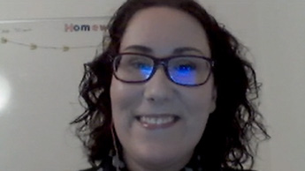
Please FOLLOW and
tell your friends! :)
https://www.facebook.com/peira.english.kosice
https://tiny.cc/FBpeiragroup
https://www.twitch.tv/peiraenglish
https://tiny.cc/peiraenglish (YouTube)

Slide 5
FREE Live English Class
Topic: Healthy Eating – Food Vocabulary

Slide 6
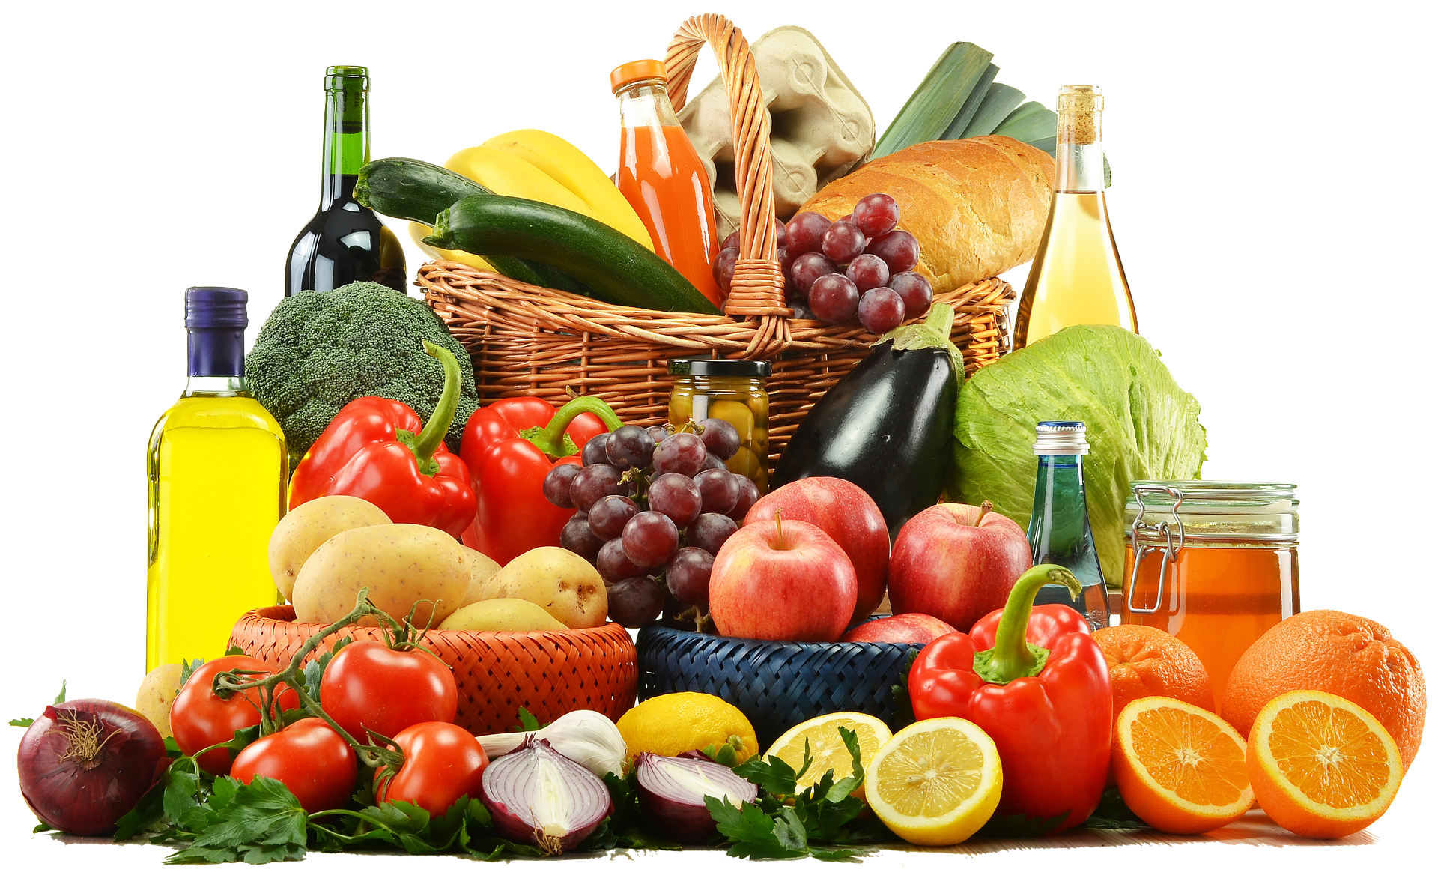
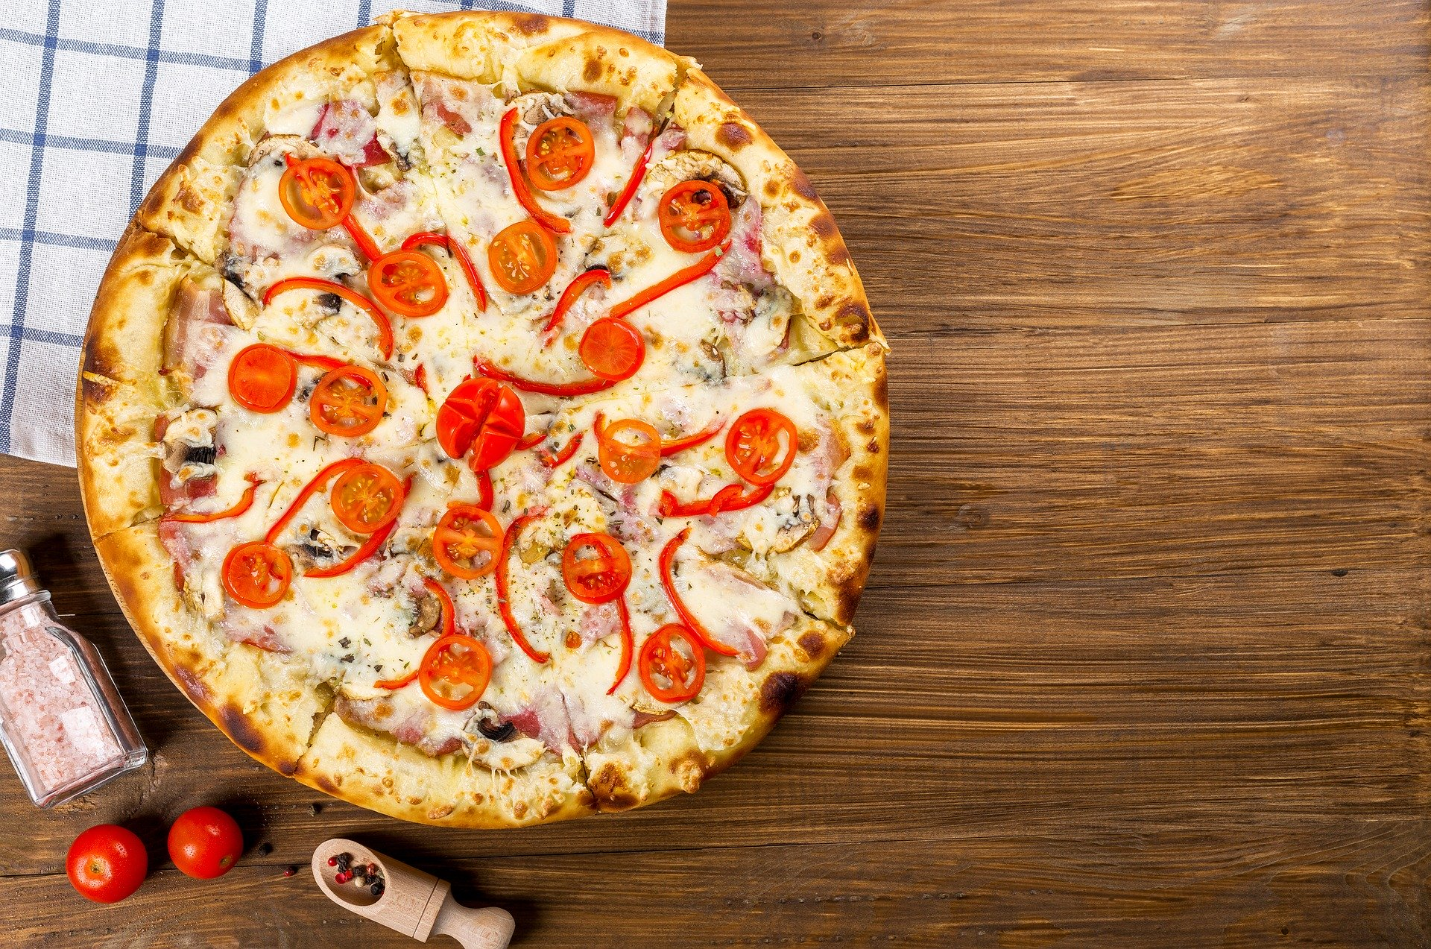
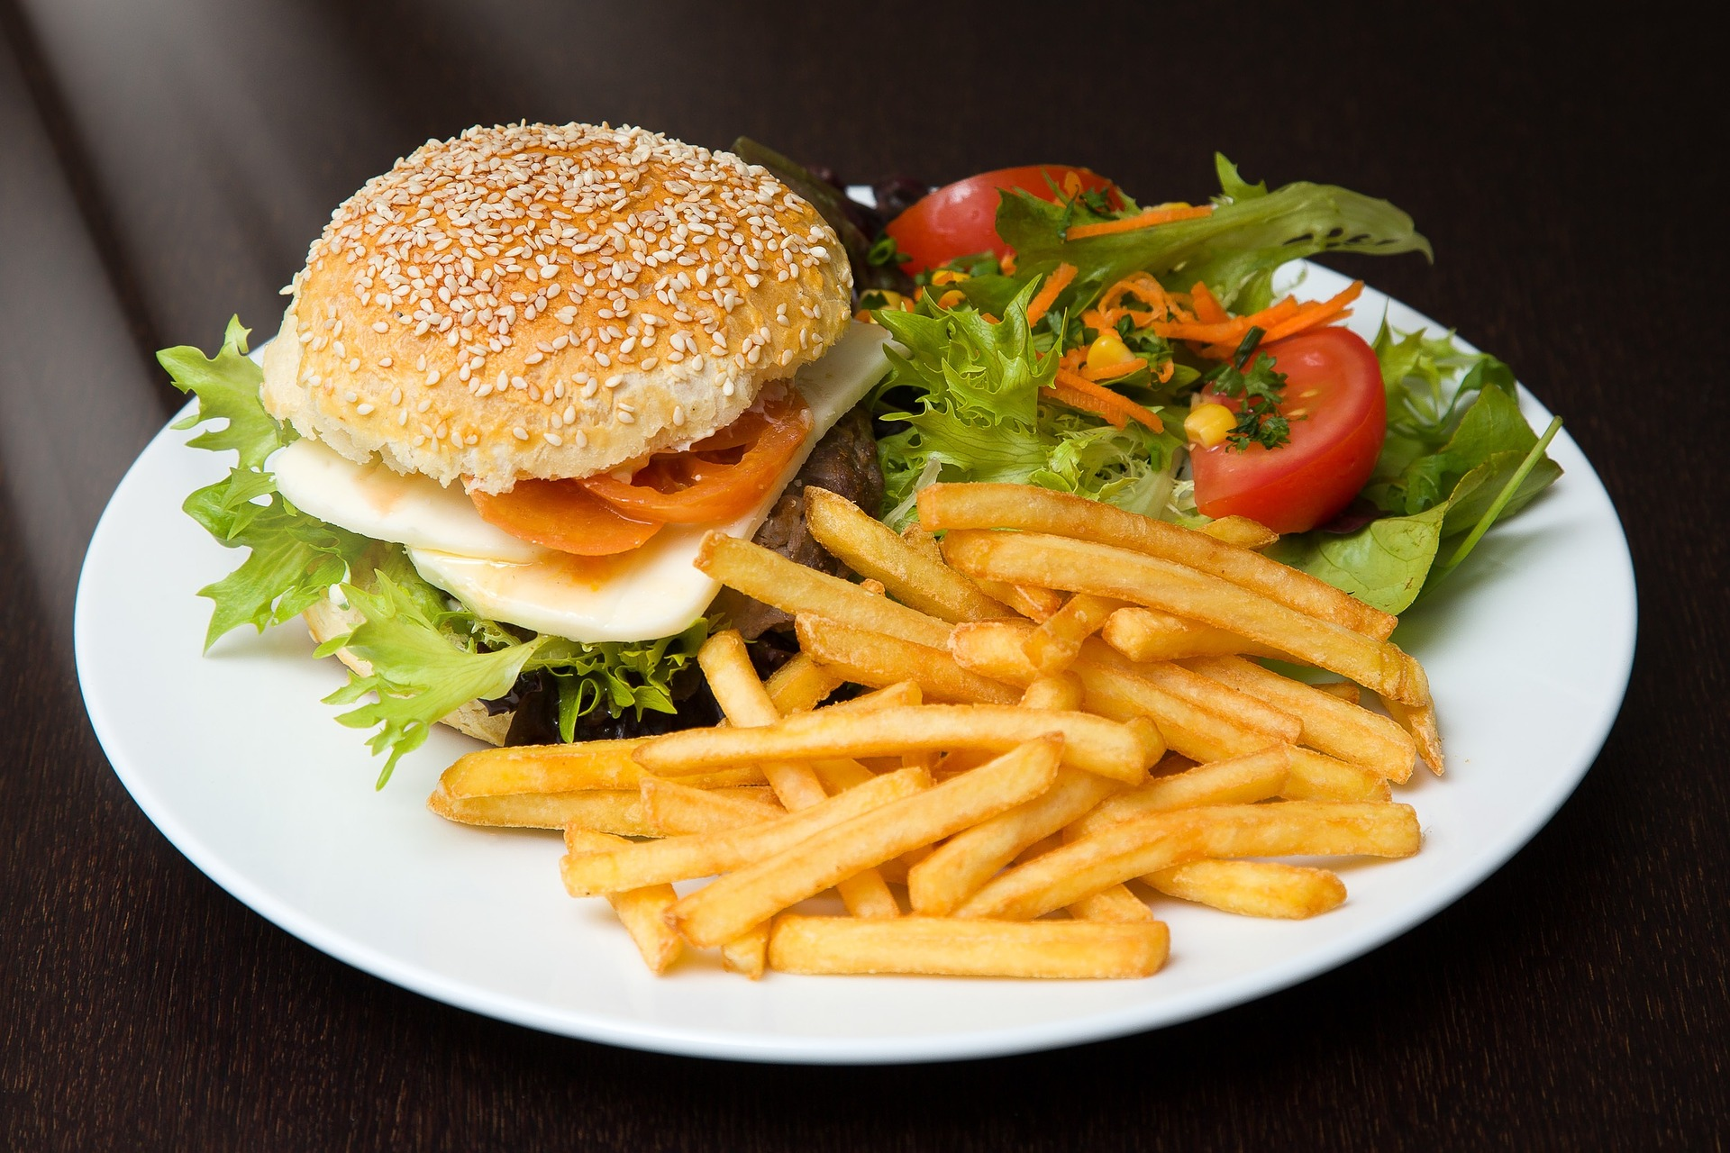
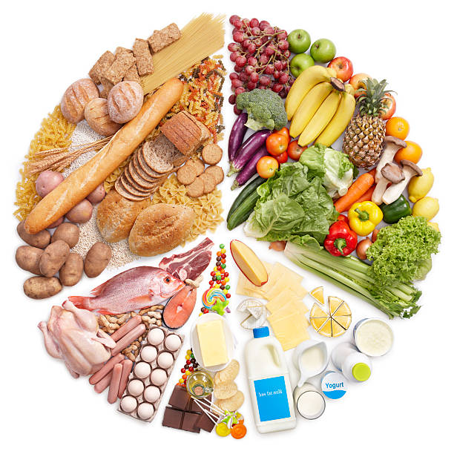
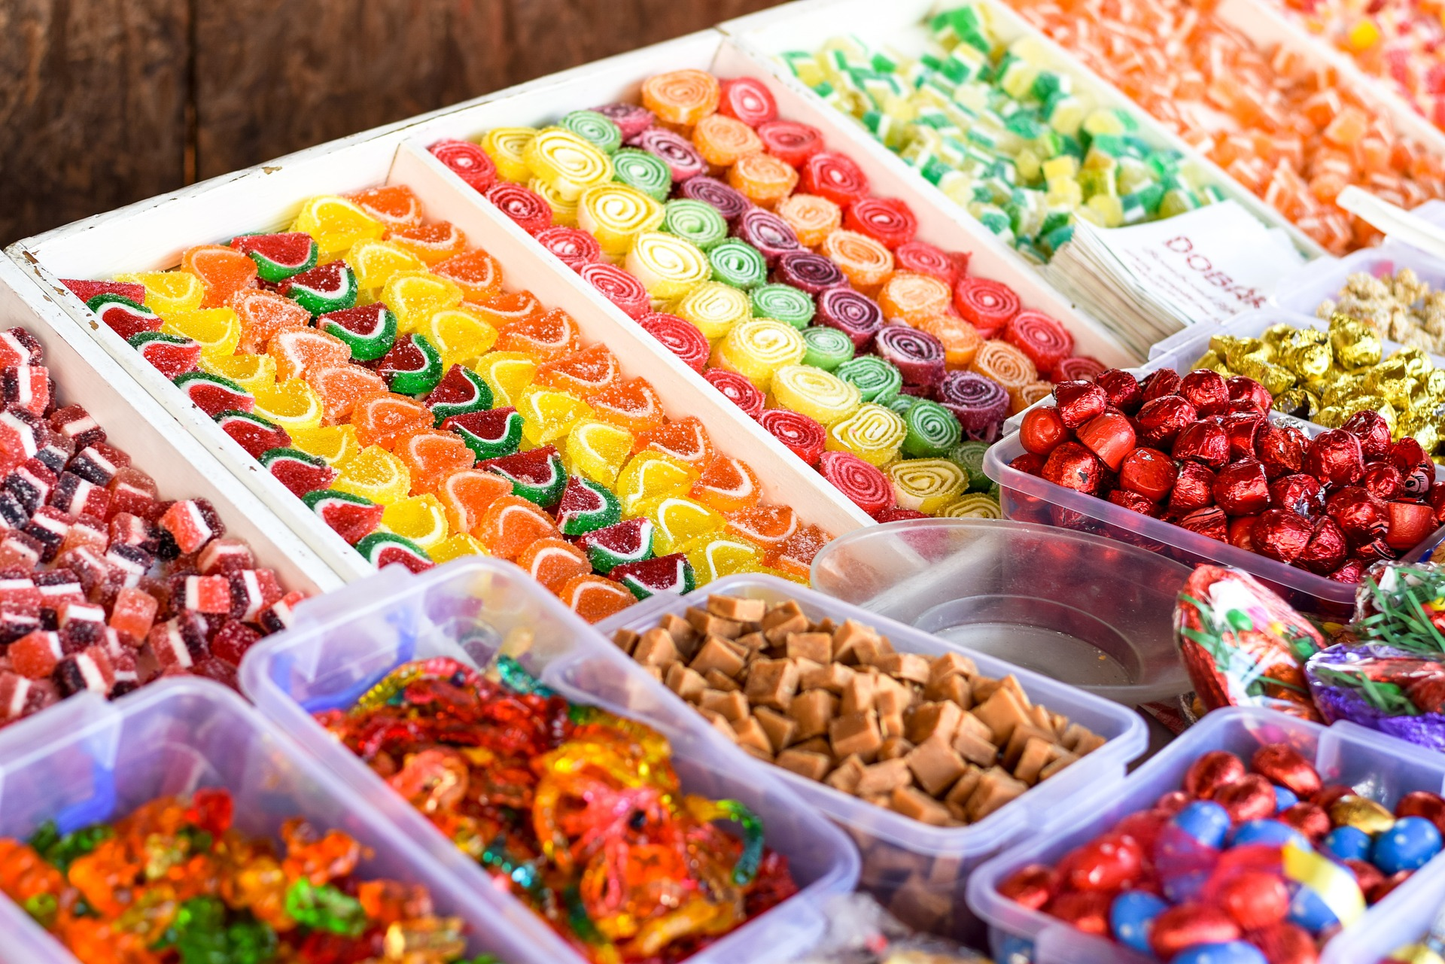
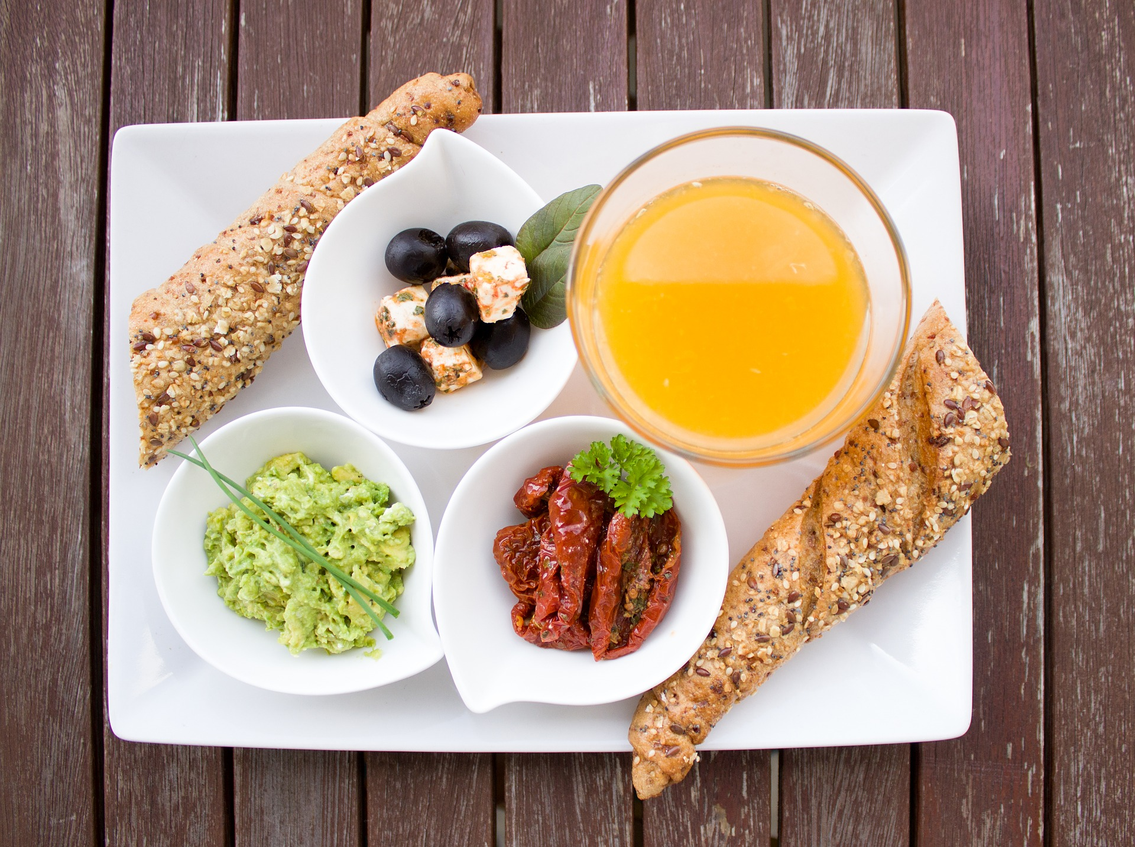
1. Discussion

Slide 7
2. Food Label Vocabulary
ingredient | H) a food that is part of another food
saturates | J) unhealthy fat in meat, eggs, milk, cheese
whole grain | F) grain that has all 3 parts intact; not refined
protein | I) substance the body needs to be strong
fibre | A) substance that travels through the body as waste
artificial | D) not natural; made by human hands
nutrition | E) what you eat and drink and how it affects your body
portion | C) the amount of food served at one time
preservatives | B) chemicals that stop food going bad
1 of your 5 a day | G) 1 of your 5 portions of fruit and vegetables that you should eat (as a minimum) every day

Slide 8
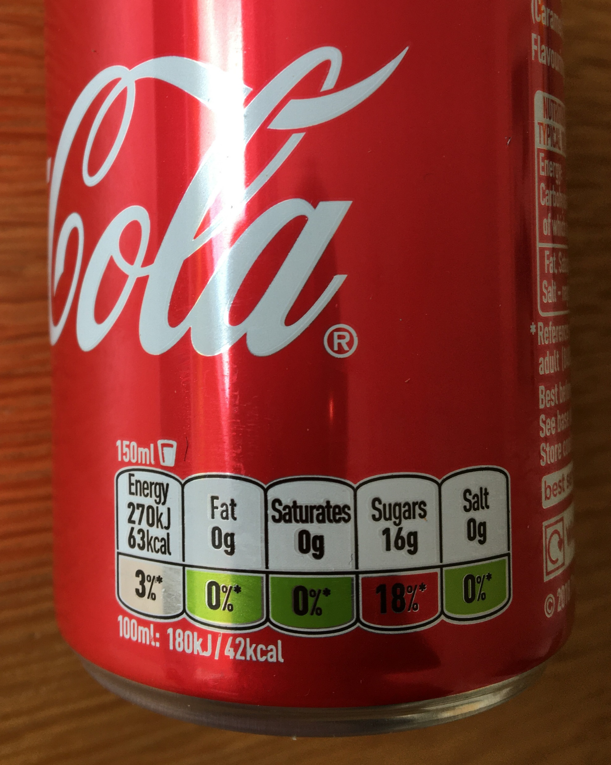
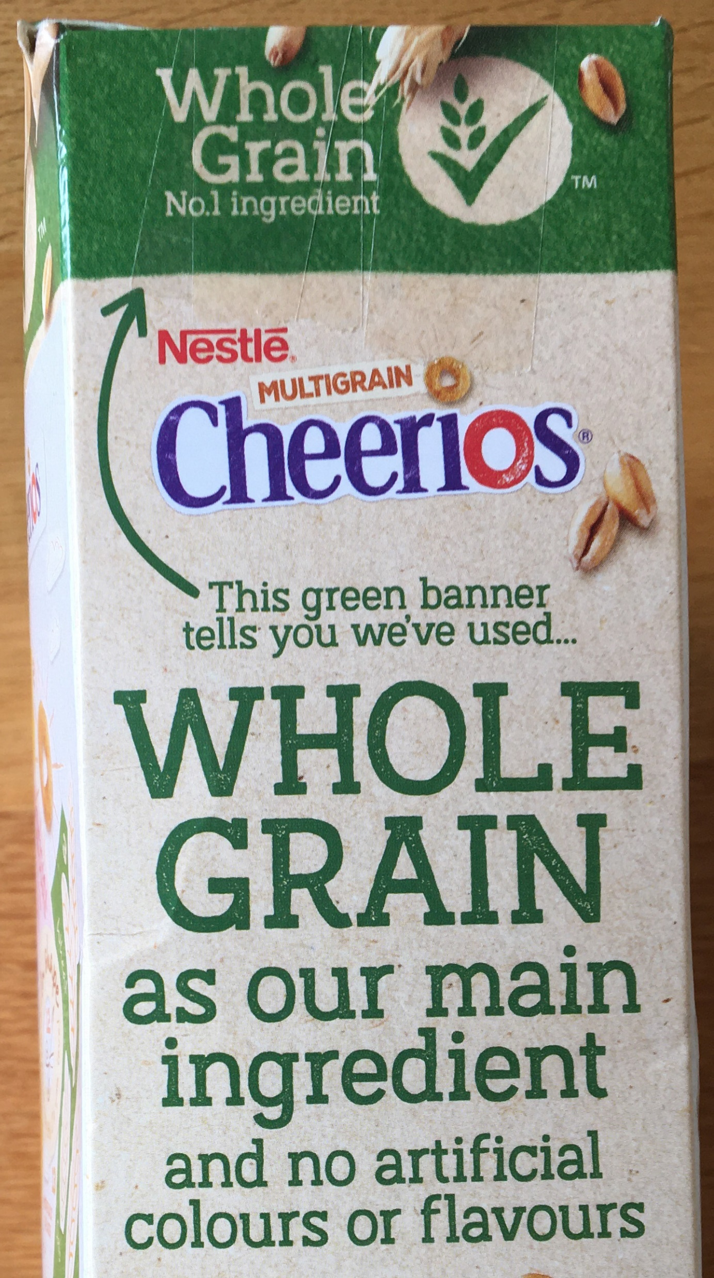
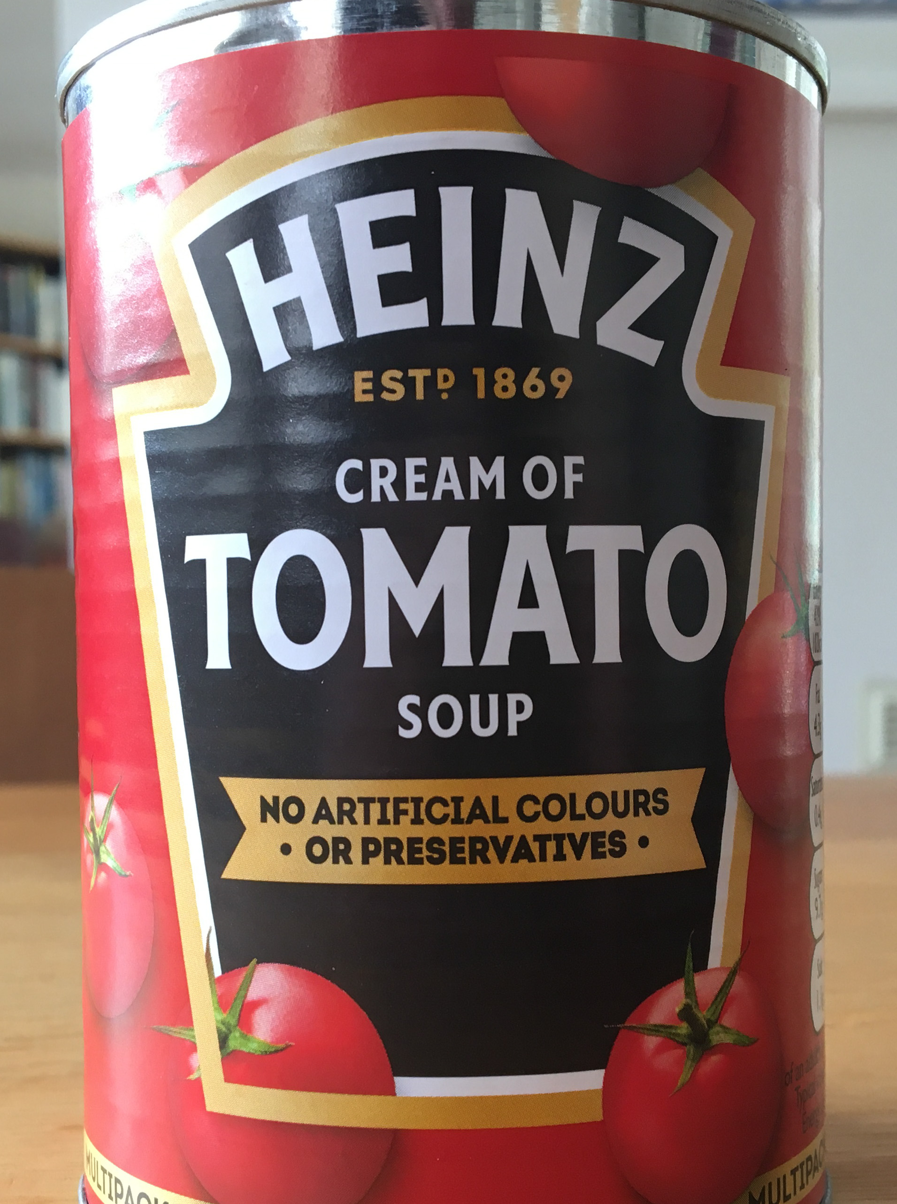
3. Reading Food Labels (1/3)

Slide 9
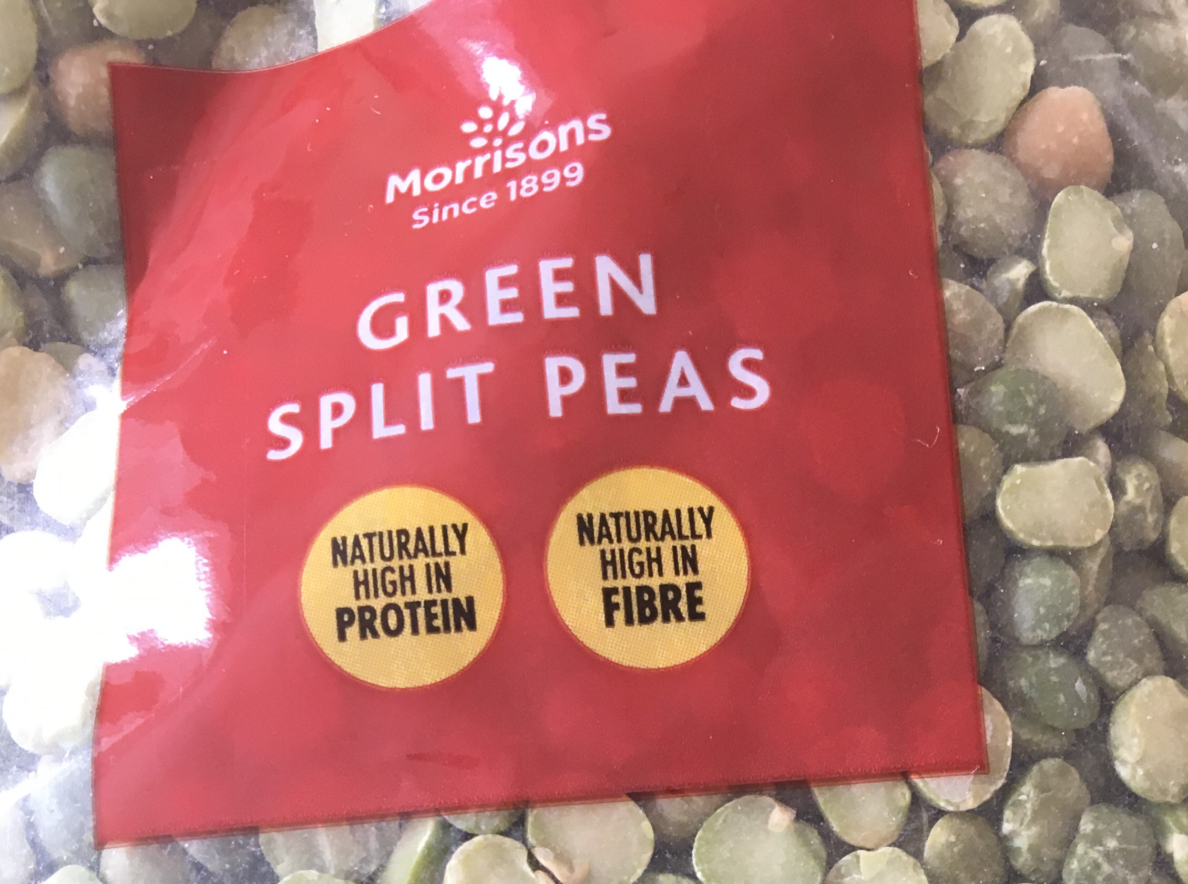
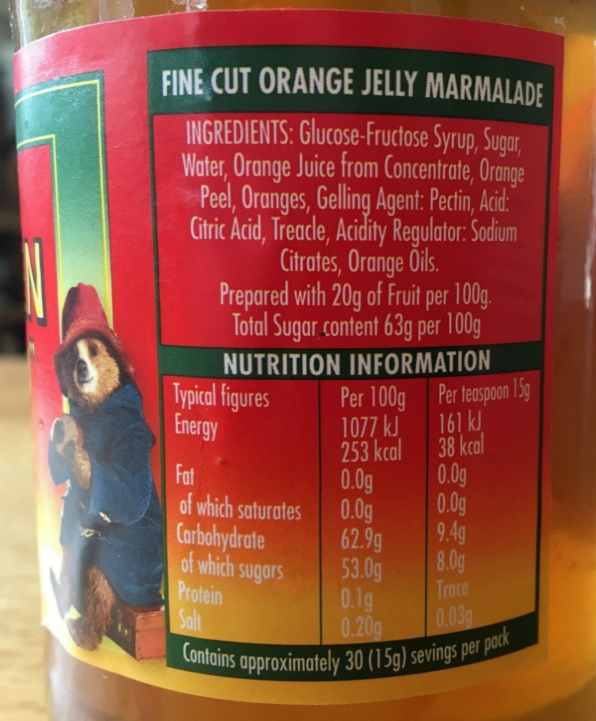
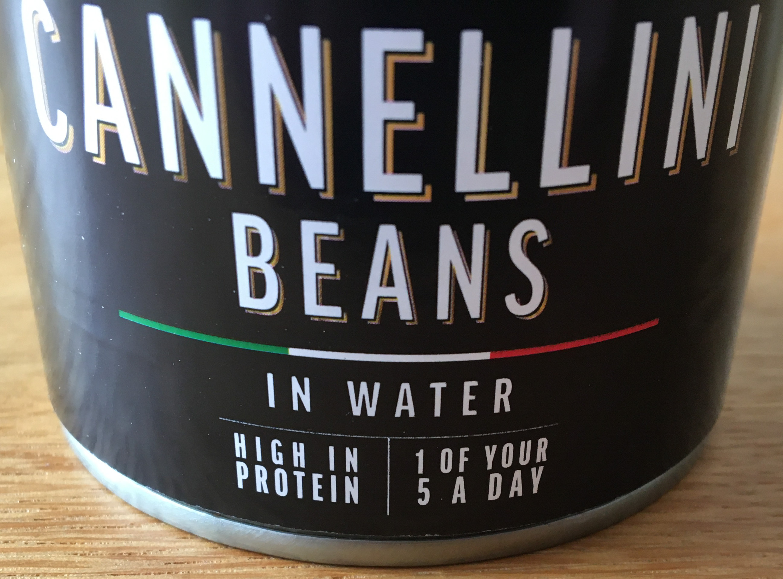
3. Reading Food Labels (2/3)
Free download:
Taking control of food portions and labels (BHF)
https://tinyurl.com/eat-well-101

Slide 10
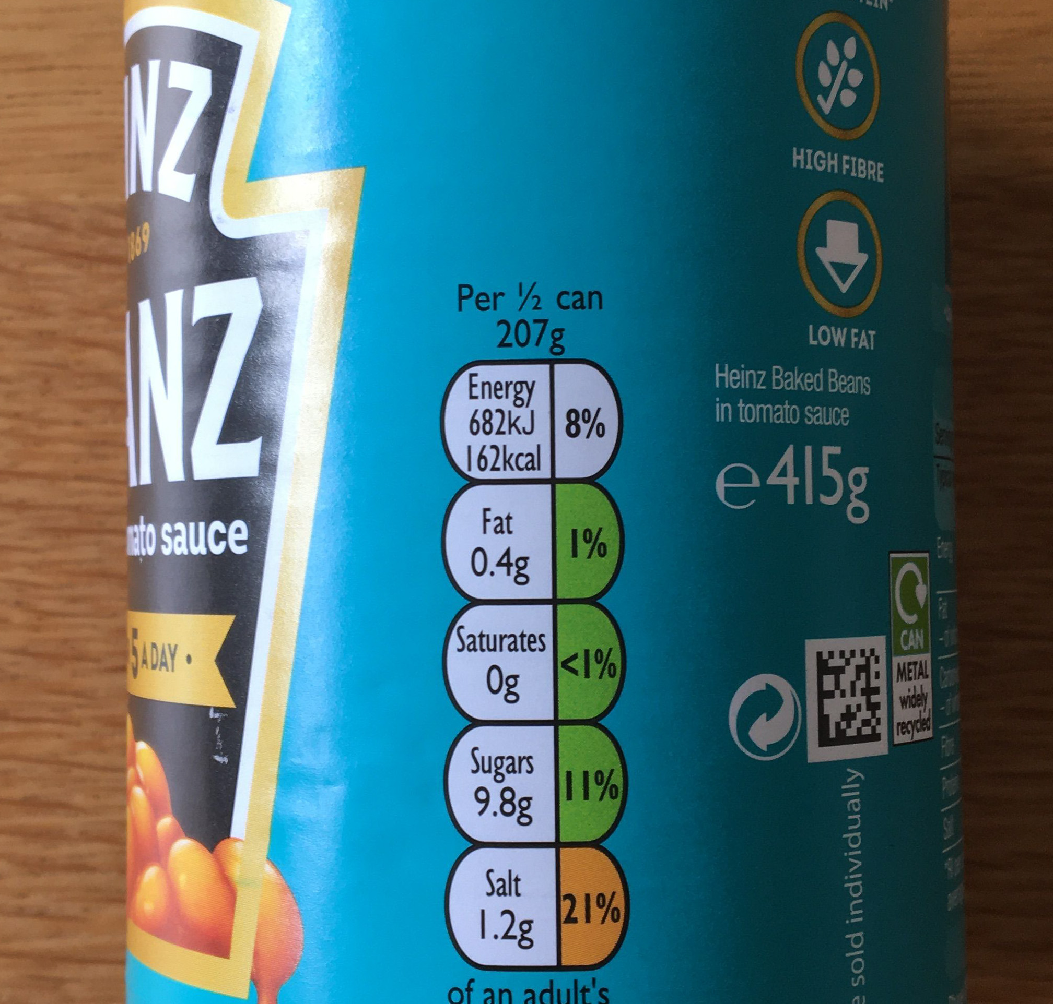
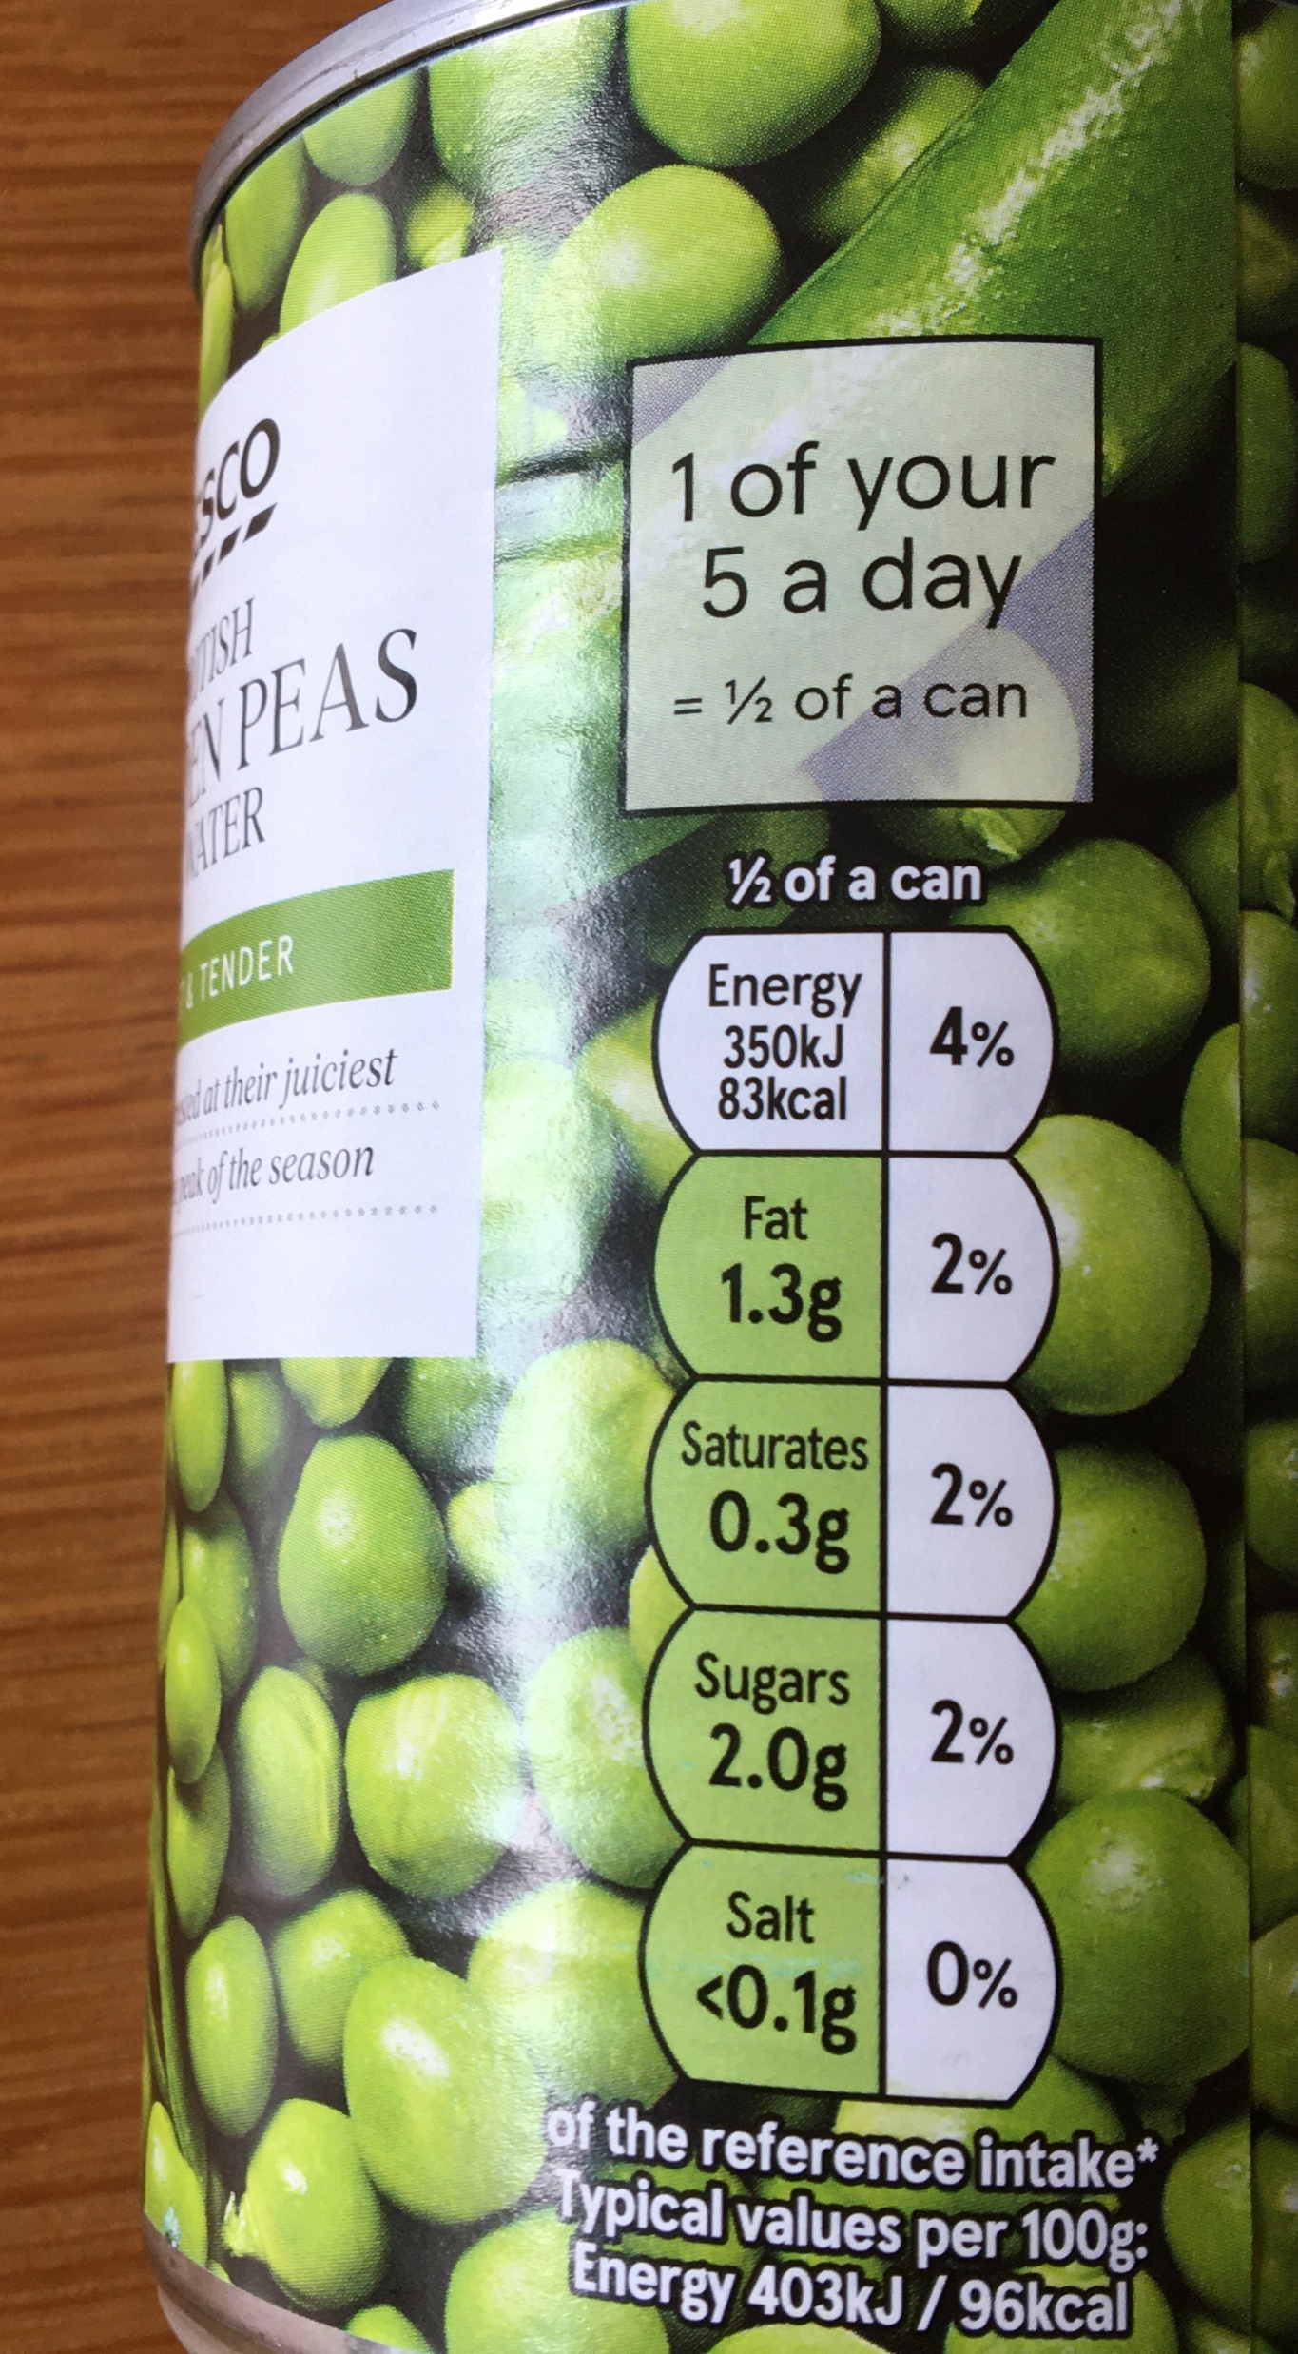
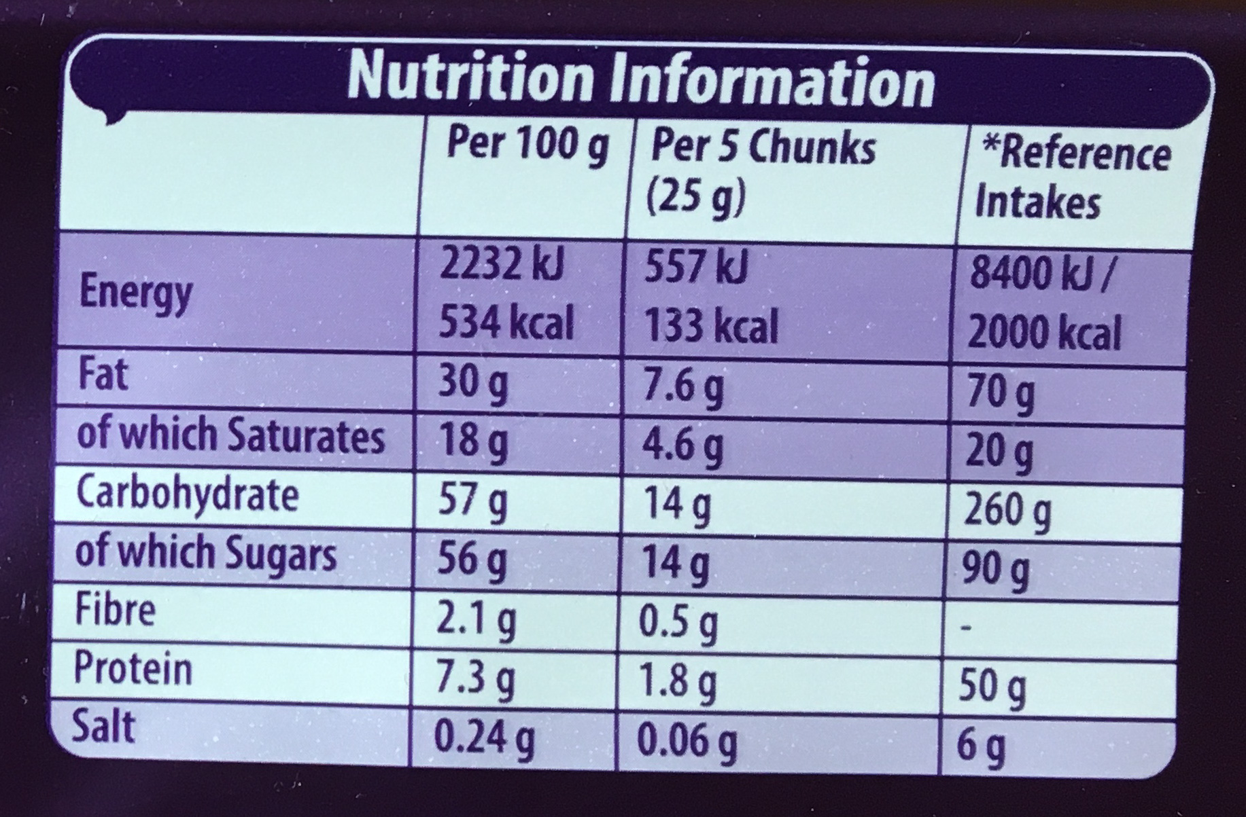
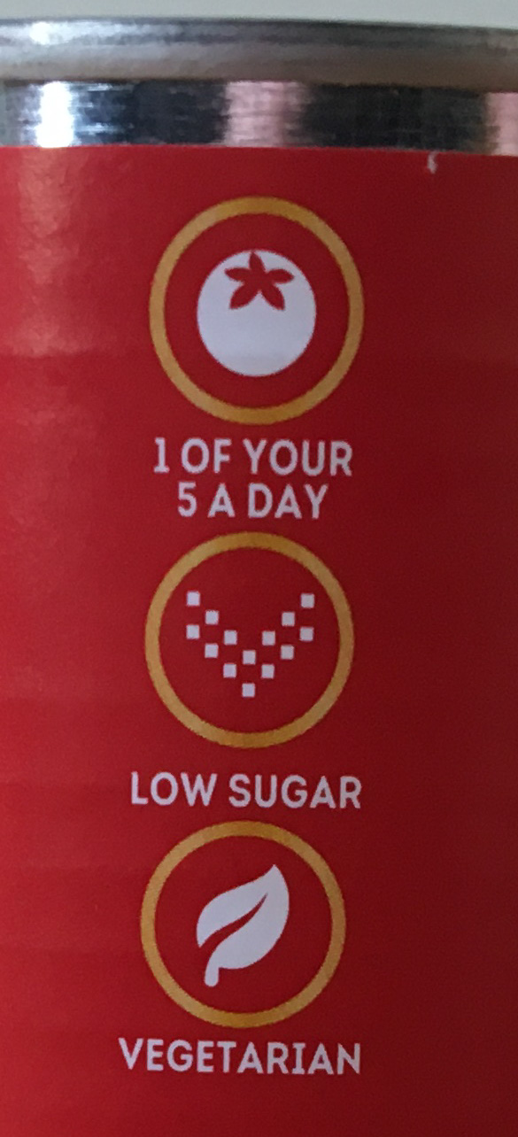
3. Reading Food Labels (3/3)

Slide 11
Notes:
XXXXX

Slide 12
https://purlandtraining.com/free-books/

Slide 13
Join us next time at 21 CET
for FREE LIVE English classes
here on Facebook Live!
https://purlandtraining.com
https://www.facebook.com/purlandtrainingcom
https://www.facebook.com/peira.english.kosice
https://tiny.cc/FBpeiragroup

