Slide 2
with Matt Purland
from PurlandTraining.com

Slide 3
please FOLLOW
and tell your friends! :)
https://www.twitch.tv/learnenglishnow
https://tiny.cc/ptyt (Purland Training - YouTube)
https://purlandtraining.com
https://twitter.com/purlandtraining
https://www.facebook.com/purlandtrainingcom/

Slide 5
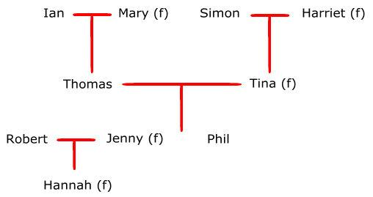
Family Vocabulary:

Slide 6
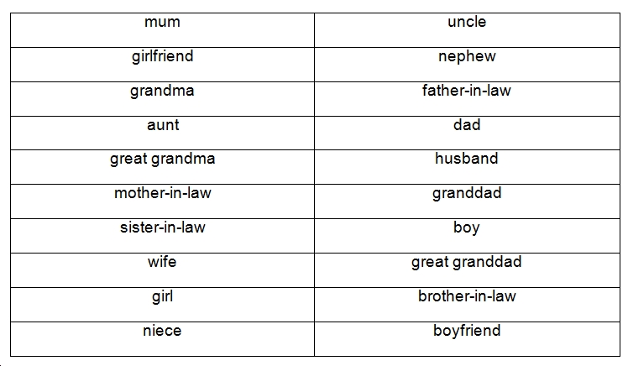
Family Vocabulary:

Slide 7
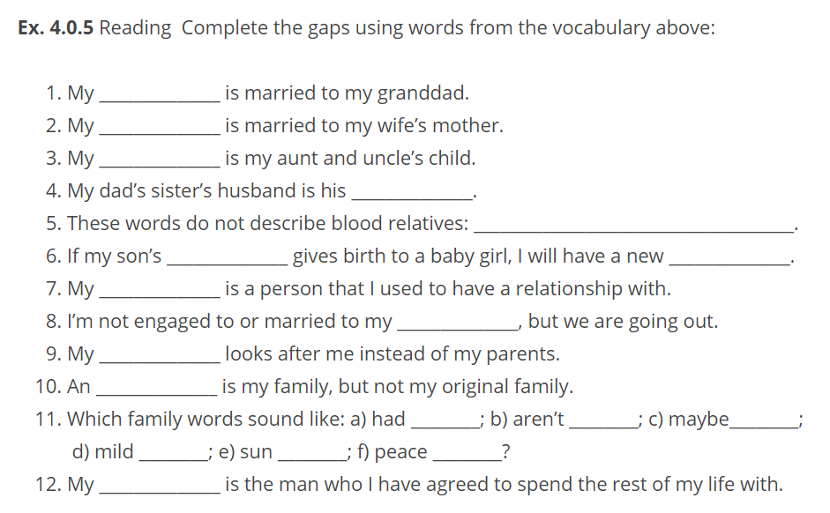
Family Vocabulary:

Slide 8
adopted family
cousin
ex-
fiancé
fiancée
foster parent
great granddad
in-laws
nibling
parent
partner
sibling
Family Vocabulary:

Slide 9
Family Vocabulary:

Slide 10
Join me every night at 20 CET
for FREE LIVE English classes
here on Twitch!
https://www.twitch.tv/learnenglishnow
https://purlandtraining.com
https://twitter.com/purlandtraining
https://www.facebook.com/purlandtrainingcom/

