Slide 2
with Matt Purland
from PurlandTraining.com

Slide 3
please FOLLOW
and tell your friends! :)
https://www.twitch.tv/learnenglishnow
https://tiny.cc/ptyt (Purland Training - YouTube)
https://purlandtraining.com
https://twitter.com/purlandtraining
https://www.facebook.com/purlandtrainingcom/

Slide 4
Tonight:
Onomatopoeic Words in English (Silly Noises)
These words SOUND LIKE the noises they describe, for example: BUBBLE, HOOT, and TWANG! How many do you know? Can you think of any more?

Slide 5
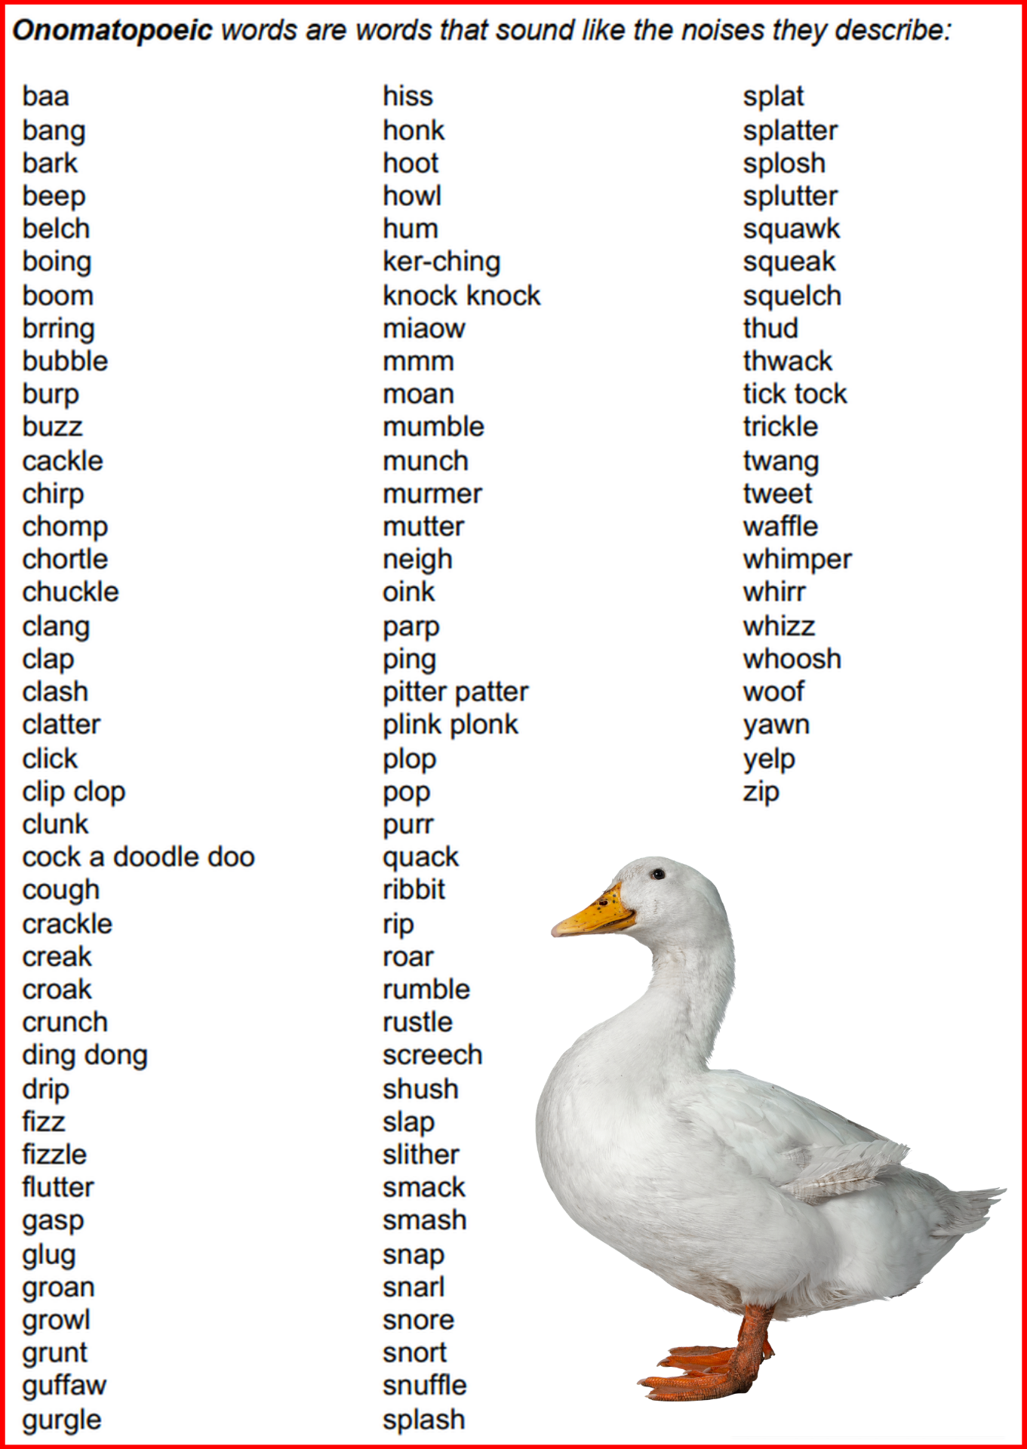

Slide 6
Onomatopoeic Words in English
What does it mean? What is it in your language:
gasp

Slide 7
Join me every night at 20 CET
for FREE LIVE English classes
here on Twitch!
https://www.twitch.tv/learnenglishnow
https://purlandtraining.com
https://twitter.com/purlandtraining
https://www.facebook.com/purlandtrainingcom/

