Slide 2
with Matt Purland
from PurlandTraining.com

Slide 3
please FOLLOW
and tell your friends! :)
https://www.twitch.tv/learnenglishnow
https://tiny.cc/ptyt (Purland Training - YouTube)
https://purlandtraining.com
https://twitter.com/purlandtraining
https://www.facebook.com/purlandtrainingcom/

Slide 4
Tonight:
Common Errors that Students Make
Translation errors

Slide 6
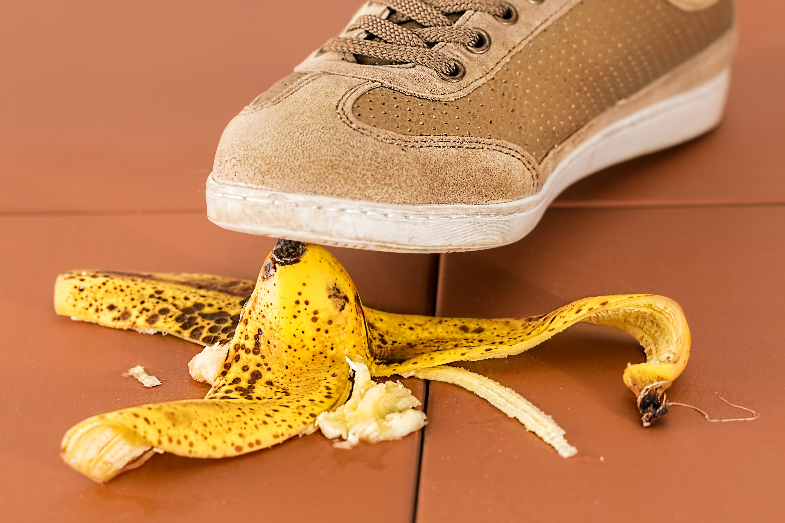
Common Errors that Students Make
I like learn English.
I heard a lot of informations.
If he will call, I will tell him.
I can’t imagine to work there.
She get the bus every day.
It is many differences.
She was angry on her brother.
I’m living in Brazil since 2010.
I felt not well.
I’ve worked here since five days.
I had so good time.
She said me to sit down.

Slide 7
Common Errors that Students Make
Notes:

Slide 8
Join me every night at 20 CET
for FREE LIVE English classes
here on Twitch!
https://www.twitch.tv/learnenglishnow
https://purlandtraining.com
https://twitter.com/purlandtraining
https://www.facebook.com/purlandtrainingcom/

