Slide 2
with Matt Purland
from PurlandTraining.com

Slide 3
please FOLLOW
and tell your friends! :)
https://www.twitch.tv/learnenglishnow
https://purlandtraining.com
https://twitter.com/purlandtraining
https://www.facebook.com/purlandtrainingcom/

Slide 4
Tonight:
12 Idioms about Sleep

Slide 5
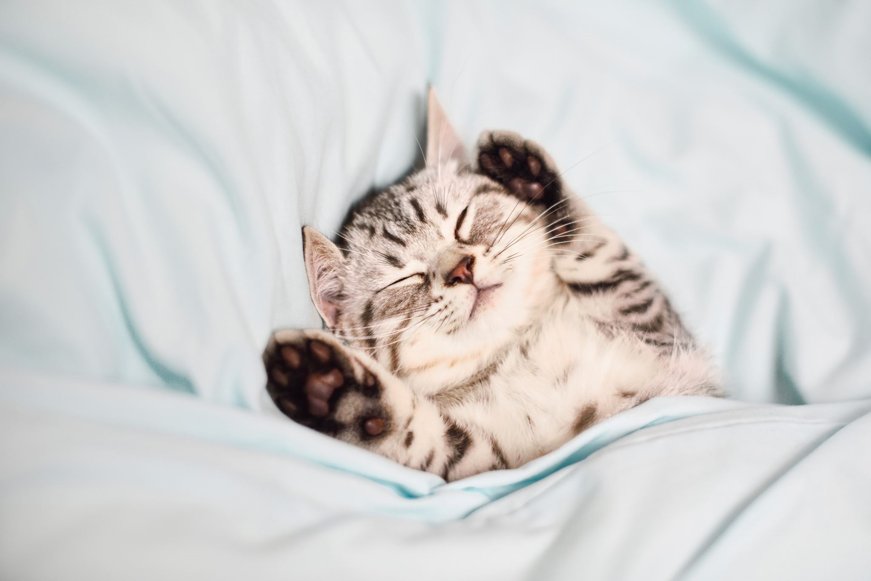
12 English Idioms about Sleep
do sth in yr sleep
my x has gone to sleep
don’t lose sleep over sth
sleep on it
sleep like a log
be a light sleeper
get your beauty sleep
put sby / sth to sleep
be caught sleeping on the job
sleep in
sleep for England
sleep tight

Slide 6
12 English Idioms about Sleep
Notes...

Slide 7
Join me every night at 20 CET
for FREE LIVE English classes
here on Twitch!
https://www.twitch.tv/learnenglishnow
https://purlandtraining.com
https://twitter.com/purlandtraining
https://www.facebook.com/purlandtrainingcom/

