Slide 1
Why doesn’t anybody care about the English language?
by Matt Purland
Image: https://pixabay.com/
www.PurlandTraining.com

Slide 2
Why doesn’t anybody care about the English language?
The problem:
English is not a phonetic language. While there are spelling rules for English (see 5 Rules for Predicting Sounds from Spelling in English), the difference between spelling and sounds in English is a big problem for learners – foreign speakers and native speakers. For example, ‘baguette’ sounds like ‘b Get’: there are 4 silent letters. Writing should reflect how words sound, but this doesn’t always happen in English. Part of the problem is that we use 26 letters to represent 48 different sounds
Words are welcomed into English from many different languages, and nobody thinks to change the spelling of words to match how we speak in English. However, it doesn’t have to be like this…
www.PurlandTraining.com

Slide 3
Why doesn’t anybody care about the English language?
The problem:
For example, in somebody thought to change these Polish words to fit Polish spelling and sounds:
Origin language: | English: | Polish:
llama (Spanish) | llama | lama
baguette (French) | baguette | bagietka
banana (Portuguese) | banana | banan
orange (Old French) | orange | pomarańcza
chauffeur (French) | chauffeur | szofer
mozzarella (Italian) | mozzarella | ser Mozzarella
www.PurlandTraining.com

Slide 4
Why doesn’t anybody care about the English language?
This does not always happen in Polish, for example the international words origami, spaghetti, and zeitgeist are spelled the same in both Polish and English. More English words are being added to Polish without changes to spelling, e.g. sale and weekend – much to the chagrin of some Polish people
As an advanced user of English, I find it difficult to spell some of the words in our list and need to spell them out in my head as I write, e.g. lieutenant. What hope is there for other learners?
Most widely-spoken languages have academies to regulate language, including grammar, spelling, and usage. For example, Académie Française (est. 1635) in France, Real Academia Española (est. 1713) in Spain, and Rada Języka Polskiego (the Polish Language Council) (est. 1996)
Despite many attempts to set up a similar organisation for English, there isn’t an Academy for English. Why not?
Somebody cares about Polish, and French, and Spanish, and many other languages. So…
why doesn’t anybody care about the English language?
www.PurlandTraining.com

Slide 5
Académie Française in Paris
https://aggslanguage.wordpress.com/2011/10/13/fight-against-franglais-french-language-website-creates-list-of-english-words-it-wants-to-ban/

Slide 6
Why doesn’t anybody care about the English language?
Rada Języka Polskiego (Polish Language Council)
www.PurlandTraining.com

Slide 7
Why doesn’t anybody care about the English language?
Instead of an Academy we have a number of self-appointed gatekeepers to the English language:
Dictionaries from august bodies, e.g. Oxford English Dictionary (f.e. 1884). ‘I would put forth the OED editors as a sort of Academy who observes and records actual use, and this is far more useful than anything with governing power
Style guides from august bodies, e.g. Oxford University (est. c. 1096), Cambridge University (est. c. 1209) and The Guardian (est. 1821), the BBC (est. 1922), etc. See also H W Fowler’s Modern English Usage (1926) and Sir Ernest Gower’s Plain Words: A Guide to the Use of English (1948)
Course book and examination writers and publishers
‘The Grammar Police’ and ‘Grammar Nazis’, e.g. on Twitter and correcting signs
Eminent influential individuals like David Crystal, Melvyn Bragg, Stephen Fry, Bill Bryson, etc.
Plain English Campaign (1979) and IATEFL (1967)

Slide 8
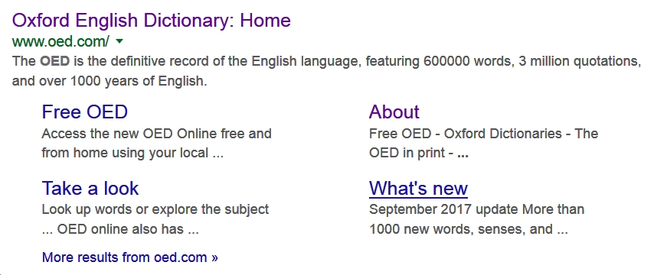
Why doesn’t anybody care about the English language?
The Oxford English Dictionary
www.PurlandTraining.com

Slide 9
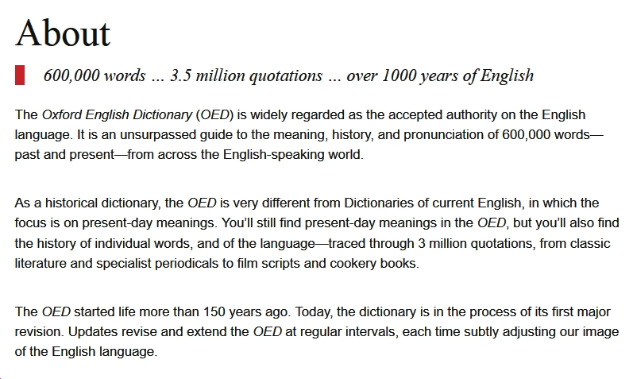
Why doesn’t anybody care about the English language?
The Oxford English Dictionary
www.PurlandTraining.com

Slide 10
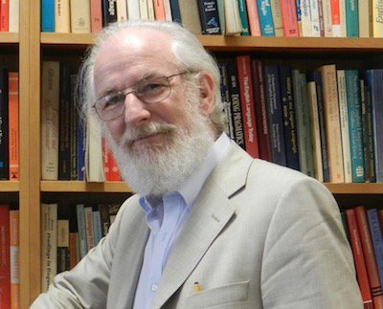
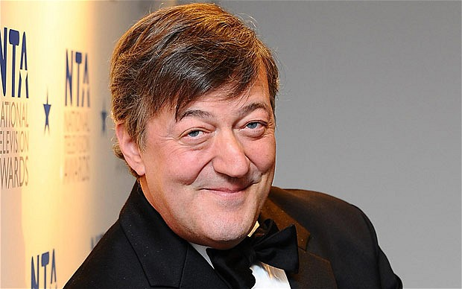
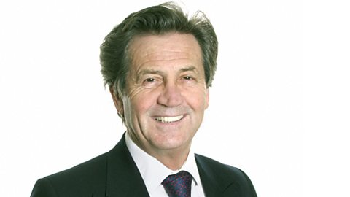
Why doesn’t anybody care about the English language?
David Crystal
Stephen Fry
Melvyn Bragg
Bill Bryson
www.PurlandTraining.com

Slide 11
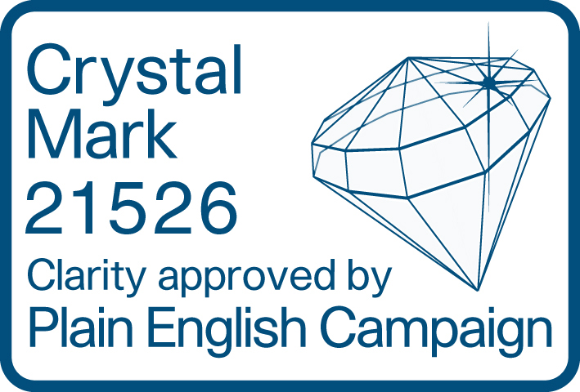
Why doesn’t anybody care about the English language?
Plain English Campaign
www.PurlandTraining.com

Slide 12
Why doesn’t anybody care about the English language?
So why don’t we have an English Academy?
Nobody wants to organise it
It’s too difficult to achieve
We like English as it is, thank you very much
There are too many vested interests against it
Appendix 1: Discussion Questions
Appendix 2: Case Study: the Polish Language Council
www.PurlandTraining.com

Slide 13
Why doesn’t anybody care about the English language?
1. Nobody wants to organise it
Throughout history there hasn’t been enough collective will to achieve this goal. Many great people have tried and failed to lasso English and ‘nail the jelly to the wall’, including (a brief history lesson):
Scribes – standardisation made things easier
The first printers – ditto. Caxton printed the first book in English in 1474
The first dictionaries – made things worse by fixing spellings that had become divorced from sounds thanks to the Great English Vowel Shift of the 1500s
1525 – William Tyndale and the first printed Bible in English
1611 – the King James Bible: ‘the most influential and most widespread religious document of the age’
1662 – Dryden and the Royal Society – overcome by events
1712 – Dryden, Defoe, and Swift
1755 – Samuel Johnson’s dictionary – favoured laissez-faire, as most experts do today
1768 – Benjamin Franklin’s ideas for spelling reform
1828 – Noah Webster’s disctionary rationalised some American spellings
www.PurlandTraining.com

Slide 14
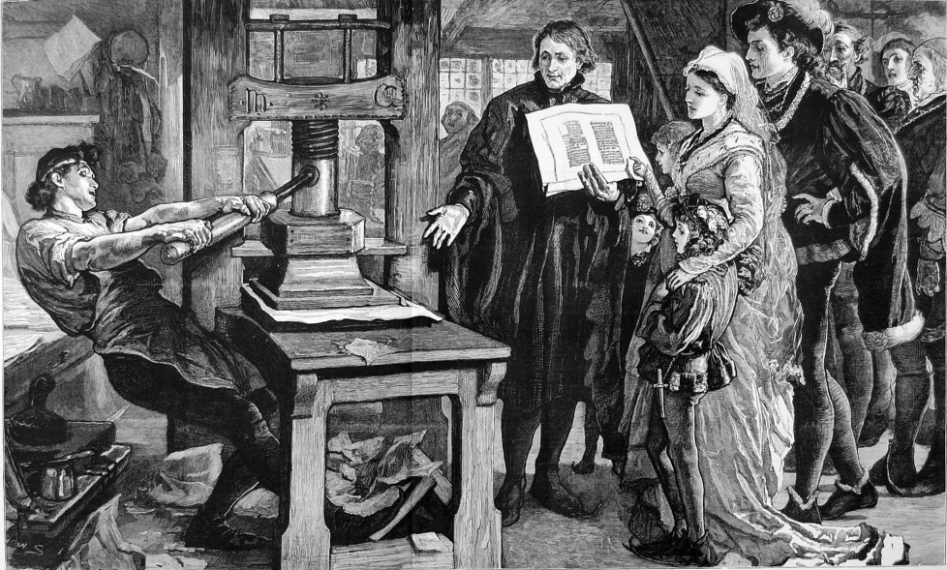
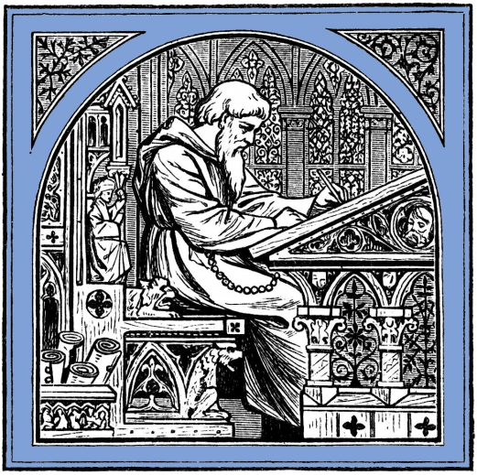
Why doesn’t anybody care about the English language?
a scribe
Caxton’s printing press
www.PurlandTraining.com

Slide 15
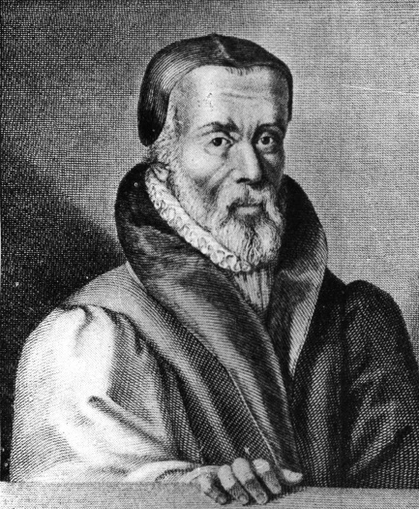
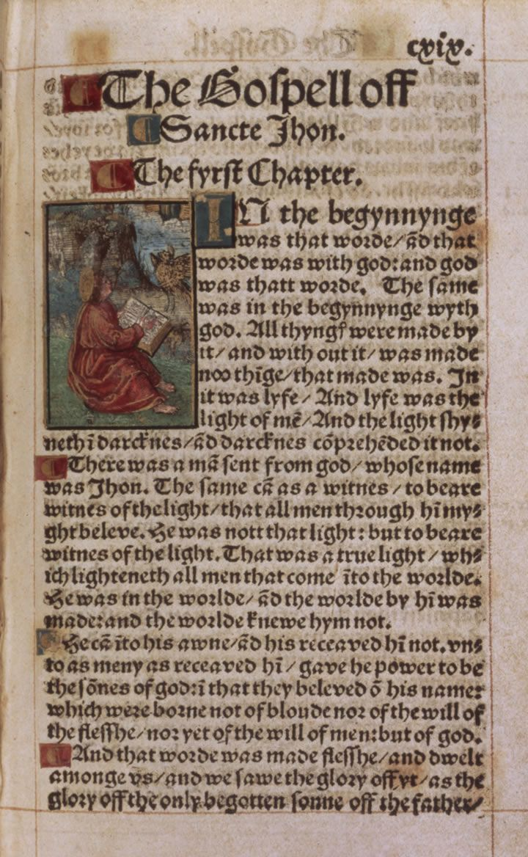
Why doesn’t anybody care about the English language?
William Tyndale
Tyndale’s Bible
www.PurlandTraining.com

Slide 16
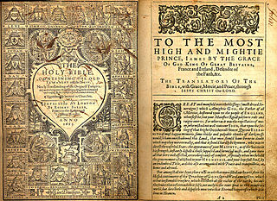
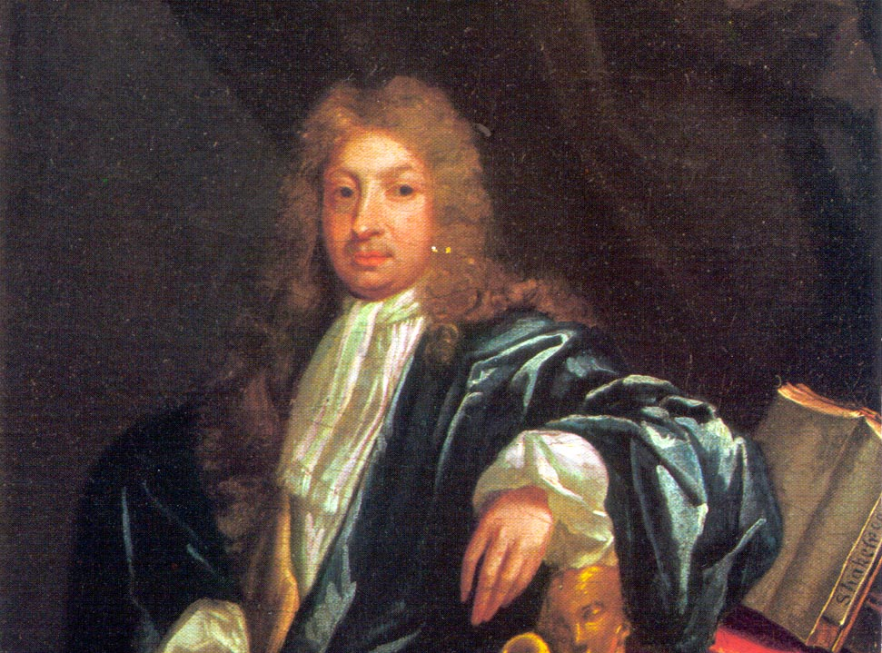
Why doesn’t anybody care about the English language?
King James Bible
John Dryden
www.PurlandTraining.com

Slide 17
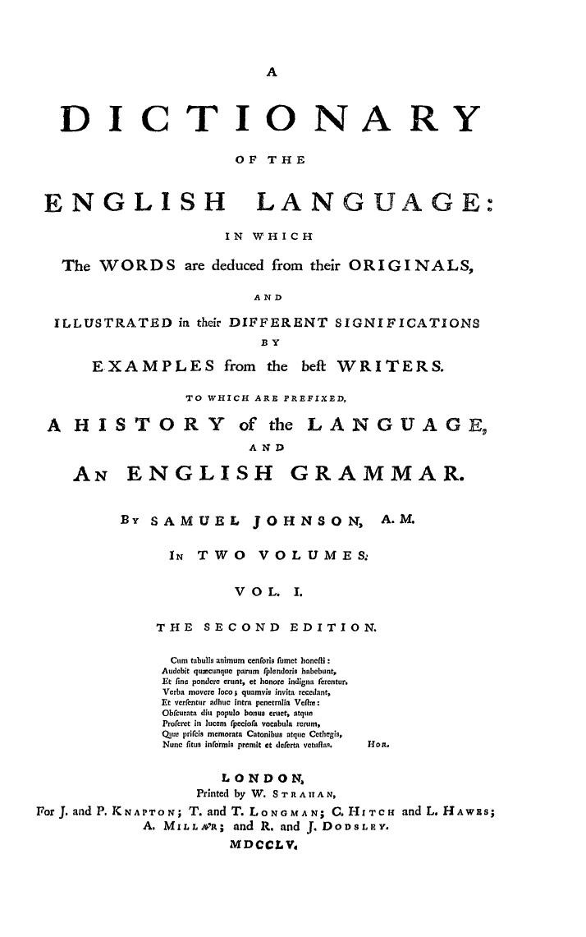
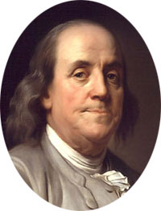
Why doesn’t anybody care about the English language?
Benjamin Franklin
Johnson’s Dictionary
www.PurlandTraining.com

Slide 18
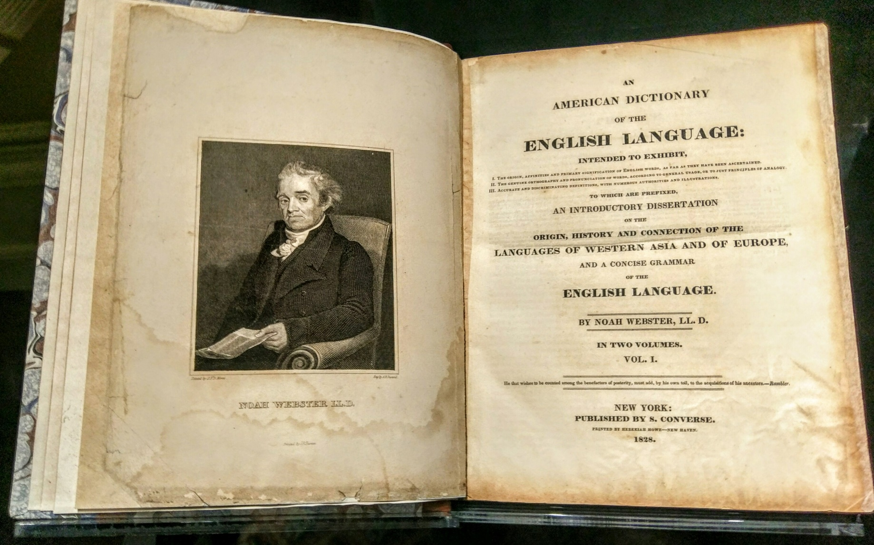
Why doesn’t anybody care about the English language?
Webster’s Dictionary
www.PurlandTraining.com

Slide 19
Why doesn’t anybody care about the English language?
1. Nobody wants to organise it
1873 – Sir Isaac Pitman’s new phonetic alphabet – led to the success of shorthand
20th century – George Bernard Shaw’s Shavian alphabet – obscurity hindered uptake
1908 – Simplified Spelling Society promoted spelling reform. Still exists, as the English Spelling Society
21st century – the Queen’s English Society – closed due to ‘lack of interest’
2012 – my attempt to rationalise spelling with the Clear Alphabet Dictionary
David Crystal: ‘Neither Britain nor the United States chose the Academy solution; and although the idea has been raised at intervals ever since, it has never found widespread support within those nations.’ (The Cambridge Encyclopaedia of the English Language)
But why not?
www.PurlandTraining.com

Slide 20
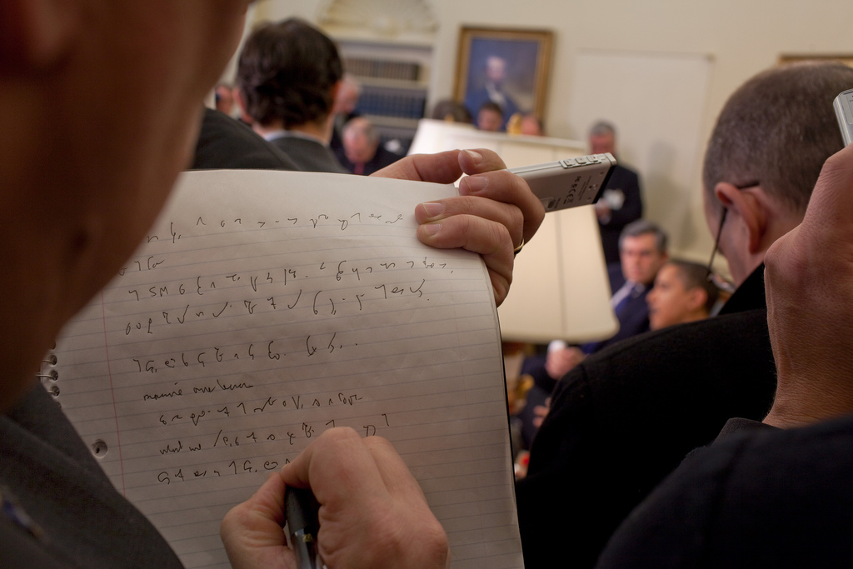
Why doesn’t anybody care about the English language?
Pitman shorthand
www.PurlandTraining.com

Slide 21
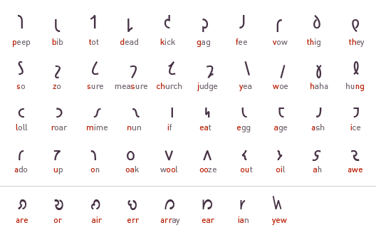
Why doesn’t anybody care about the English language?
Shavian Alphabet
www.PurlandTraining.com

Slide 22
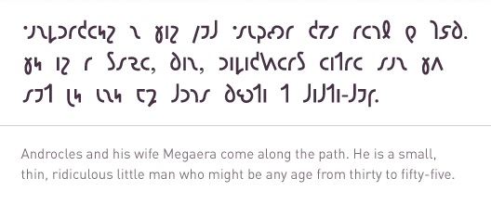
Why doesn’t anybody care about the English language?
Shavian Alphabet
www.PurlandTraining.com

Slide 23
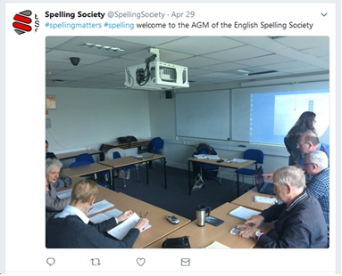
Why doesn’t anybody care about the English language?
www.PurlandTraining.com

Slide 24
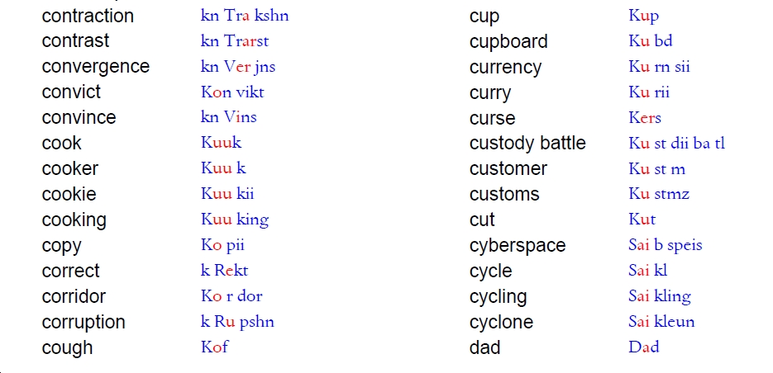
Why doesn’t anybody care about the English language?
Clear Alphabet (2012)
www.PurlandTraining.com

Slide 25
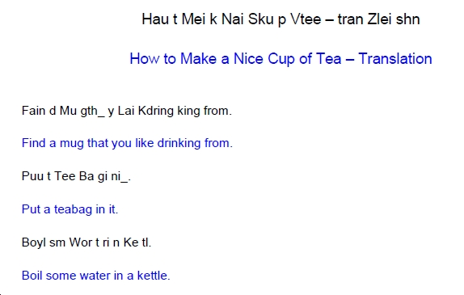
Why doesn’t anybody care about the English language?
Clear Alphabet (2012)
www.PurlandTraining.com

Slide 26
Why doesn’t anybody care about the English language?
But without wishing to ‘scare the horses’ with radical reform, could we not reform spelling
just a little, so that llama becomes lama for the next generation of people?
We could change:
llama | lama | loch | lock
gherkin | gerkin | orange | orinj
khaki | kaki | whisky | wisky
spaghetti | spagetti | ceilidh | kayly
www.PurlandTraining.com

Slide 27
Why doesn’t anybody care about the English language?
2. It’s too difficult to achieve
It is doomed to fail. English spelling was ‘wrong’ from the start because the Roman alphabet was not suitable for recording Anglo Saxon speech
The English vocabulary is too big: “English is such a mess of a language that any attempt to regulate it would be a waste of time.” (Forum user: http://www.antimoon.com/forum/t16502.htm)
Psychology: ‘It is very difficult to change learned behaviour patterns of the entire population.’
Too controversial – nobody wants to suggest it. We are emotionally attached to our spellings
It would be too expensive. Who would pay for it? Which worthy causes need our money more?
Thanks to trade and the Empire, English spread around the world too rapidly to control it
Reformers do not agree on one system to be the solution
www.PurlandTraining.com

Slide 28
Why doesn’t anybody care about the English language?
3. We like English the way it is
Reform is ‘unnecessary’. We prefer freedom and creativity over ‘sensible’ uniformity
The English dislike for and distrust of the expert and people telling us what to do
English has always changed and evolved, soaking up words and phrases from other languages and is the richer for it. Languages grow and contract naturally like a living organism
English excels in is its malleability/adaptability – we are proud of that and appreciate it
The freedom to use English however you want to creates one-upmanship which would not exist if there was a ‘right’ and a ‘wrong’ way to say / write something
Posturing – ‘look how broad-minded we are by accepting words from many different languages!’
Once learned – after a lot of time and intense study – I don’t take kindly to somebody’s attempts to make it easier; I jealously guard my hard-won knowledge!
www.PurlandTraining.com

Slide 29
Why doesn’t anybody care about the English language?
4. There are too many vested interests against it
We have accomplished so many great things in many fields. Why not simply create a central resource and authority for the English language and house it in a wonderful old building?
In my opinion it is possible to set up such an organisation, but the existence of a Royal (?) English Academy would perhaps be a massive threat to the established vested interests of the big players in the fields of English language – nobody wants to upset the apple cart. There are too many small and medium sized principalities which are unwilling to join together and become one kingdom
Can you imagine x cooperating with y for a non-commercial goal?
English is a difficult language to learn but is it in anybody’s interests to make it easier to learn?
For example: if all verbs became regular with -ed endings it would make it vastly easier to learn English and use it correctly. We could do it, if somebody ‚laid down the law’ (c.f. going decimal, or Brexit) but why make it easier for learners?
www.PurlandTraining.com

Slide 30
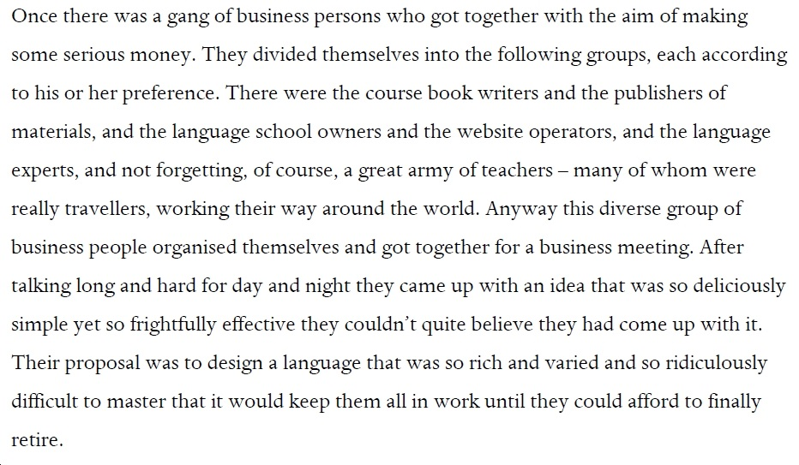
Why doesn’t anybody care about the English language?
You Are The Course Book (2012)
www.PurlandTraining.com

Slide 31
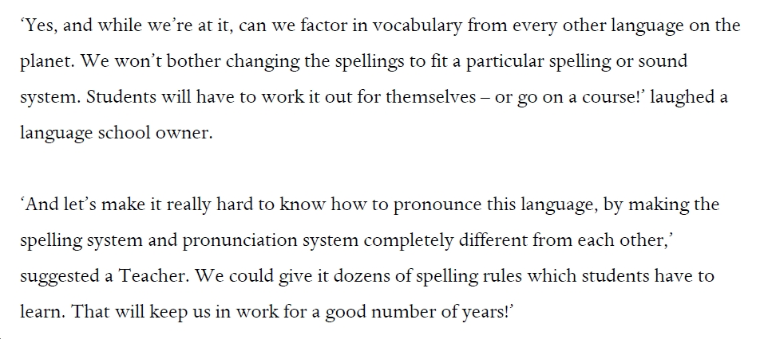
Why doesn’t anybody care about the English language?
You Are The Course Book (2012)
www.PurlandTraining.com

Slide 32
Why doesn’t anybody care about the English language?
Appendix 1: Discussion Questions
Are there rules in the English language at the moment? If yes, who defined them? How strict are they? How are they enforced?
What would you do if you were in charge of English? How would you define ‘correct’ and ‘bad’ English? How does it relate to a) age, b) location, c) class, d) wealth, e) education, f) parenting, etc.? How would you enforce ‘correct’ (good) language use?
Agree or disagree: Today – spelling is generally agreed on and fixed, but fixed wrongly!
Who would be elected to a proposed English Academy? On what merit would they be elected?
How useful are the stated tasks of the Polish Language Council (Appendix 2)? Has Poland taken more care of its mother tongue than the UK? What do you think would be the effects if there was a body to discuss and rule on matters relating to the English language?
Do you agree that people do care about English, but they care more about their own interests?
www.PurlandTraining.com

Slide 33
Why doesn’t anybody care about the English language?
Proposition:
The good news is that many people do care about the English language.
Unfortunately, the most influential among them care more about their own interests.
Do you agree or disagree with this? Why?
www.PurlandTraining.com

Slide 34
Why doesn’t anybody care about the English language?
Appendix 2: Case Study: the Polish Language Council
The Polish Language Council (Polish: Rada Języka Polskiego) is the official language regulating organ of the Polish language. It was established on 9 September 1996 as a Commission of the Polish Academy of Sciences pursuant to the ‘Polish Language Act’ (Polish: ‘Ustawa o języku polskim’) of 7th October 1999.
The council is composed of 36 members, including linguists, scientists, other specialists (e.g., in law, history of art, computer science, medicine, physics). It is tasked with advisory duties.
The stated tasks of the council are:
analysis and evaluation of the condition of the Polish language and advising on the state language policy;
promoting knowledge about the Polish language, its variations, standards, and the criteria for evaluation of its usage; organization of discussions and conferences to this aim;
making decisions on disputes over elements of the language (vocabulary, grammar, spelling, punctuation, and syntax);
establishing rules for spelling and punctuation;
finding solutions for usage of the Polish language in science and technology (primarily in emerging disciplines);
evaluation of the names for new commercial products and services, and taking care of the language culture in Polish language schools;
expressing views on non-standardized given names for children;
review of texts published by the Polish media and public administration.
https://en.wikipedia.org/wiki/Polish_Language_Council
www.PurlandTraining.com

Slide 35
Why doesn’t anybody care about the English language?
Selected Sources:
The Cambridge Encyclopaedia of the English Language
Great Tales from English History, Lacey R., Abacus, 2003
Clear Alphabet Dictionary, Purland Matt, 2012
5 Rules for Predicting Sounds from Spelling in English, Purland Matt
Article 1: ‘A brief history of English spelling reform’, Stan Carey; http://www.historytoday.com/stan-carey/brief-history-english-spelling-reform
Article 2: ‘Spelling and Standardization in English: Historical Overview’, Prof. Suzanne Kemmer; http://www.ruf.rice.edu/~kemmer/Histengl/spelling.html
http://www.bl.uk/learning/timeline/item126681.html
http://timelines.phil.hhu.de/event/swift-and-defoe-s-language-academy
https://en.wikisource.org/wiki/The_Works_of_the_Rev._Jonathan_Swift/Volume_5/A_Proposal_For_Correcting,_Improving,_and_Ascertaining_the_English_Tongue
https://www.omniglot.com/writing/franklin.htm
http://www.spellingsociety.org/
https://triangulations.files.wordpress.com/2014/09/history_of_english4.png
http://www.arrantpedantry.com/2014/12/01/celtic-and-the-history-of-the-english-language/
https://en.wikipedia.org/wiki/Polish_Language_Council

